Slide 1
AWS LAB PROCEDURES
BY
A.NAVYA SRI ALEKHYA
20A31A4203

Slide 2
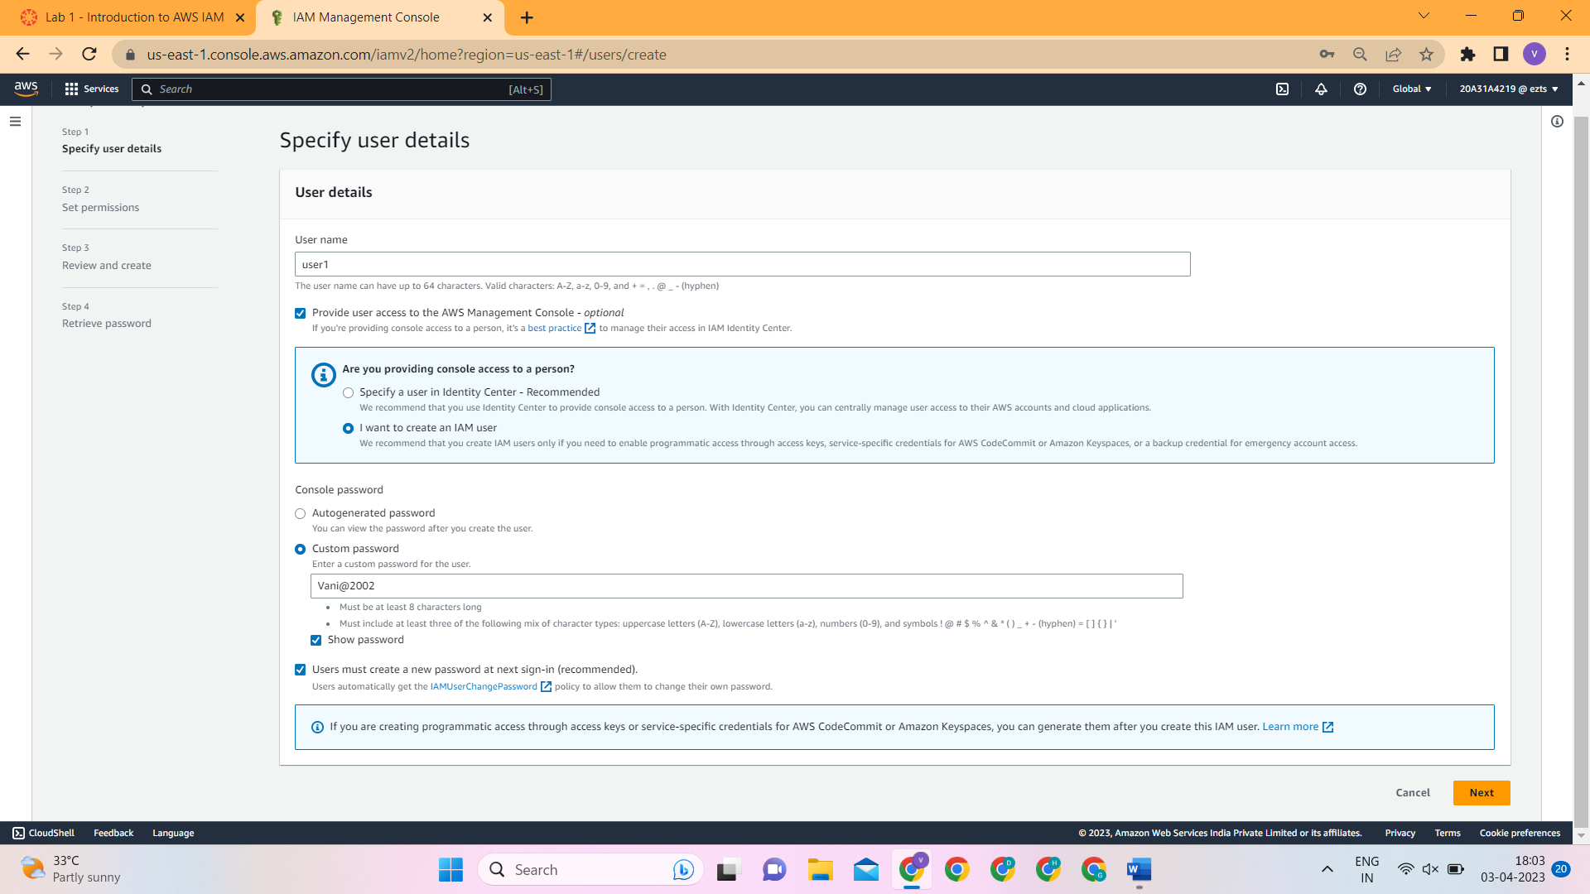
LAB 1:INTRODUCTION TO AWS IAM
Task 1: Explore the Users and Group
Step1:In the AWS Management Console, on the Services menu, select IAM.
Step2:In the navigation pane on the left, choose Users.
Step3:Create the user with the following name.
user-1
Step4:Click Next and click Create user

Slide 3
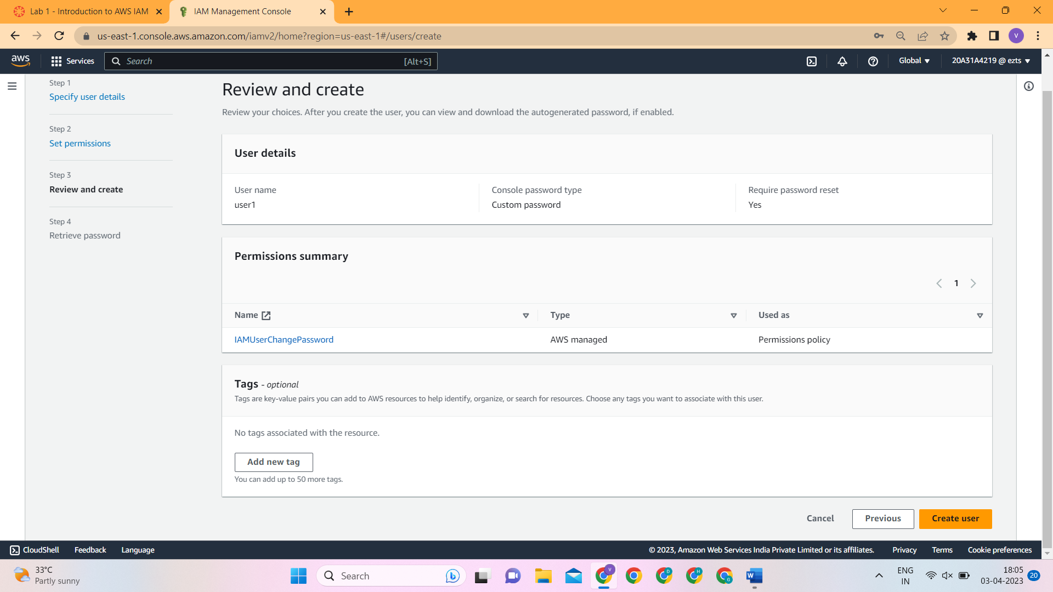
Notice that user-1 does not have any permissions.
Step 5: Choose the Groups tab.
user-1 also is not a member of any groups.
Step 6: Choose the Security credentials tab.
user-1 is assigned a Console password
Step 7: In the navigation pane on the left, choose User groups.
Choose the EC2-ReadOnlyAccess group.
This will bring you to the summary page for the EC2-Support group.
Step 8: Choose the Permissions tab.
This group has a Managed Policy associated with it, called AmazonEC2ReadOnlyAccess. Managed Policies are pre-built policies (built either by AWS or by your administrators) that can be attached to IAM Users and Groups. When the policy is updated, the changes to the policy are immediately apply against all Users and Groups that are attached to the policy.

Slide 4
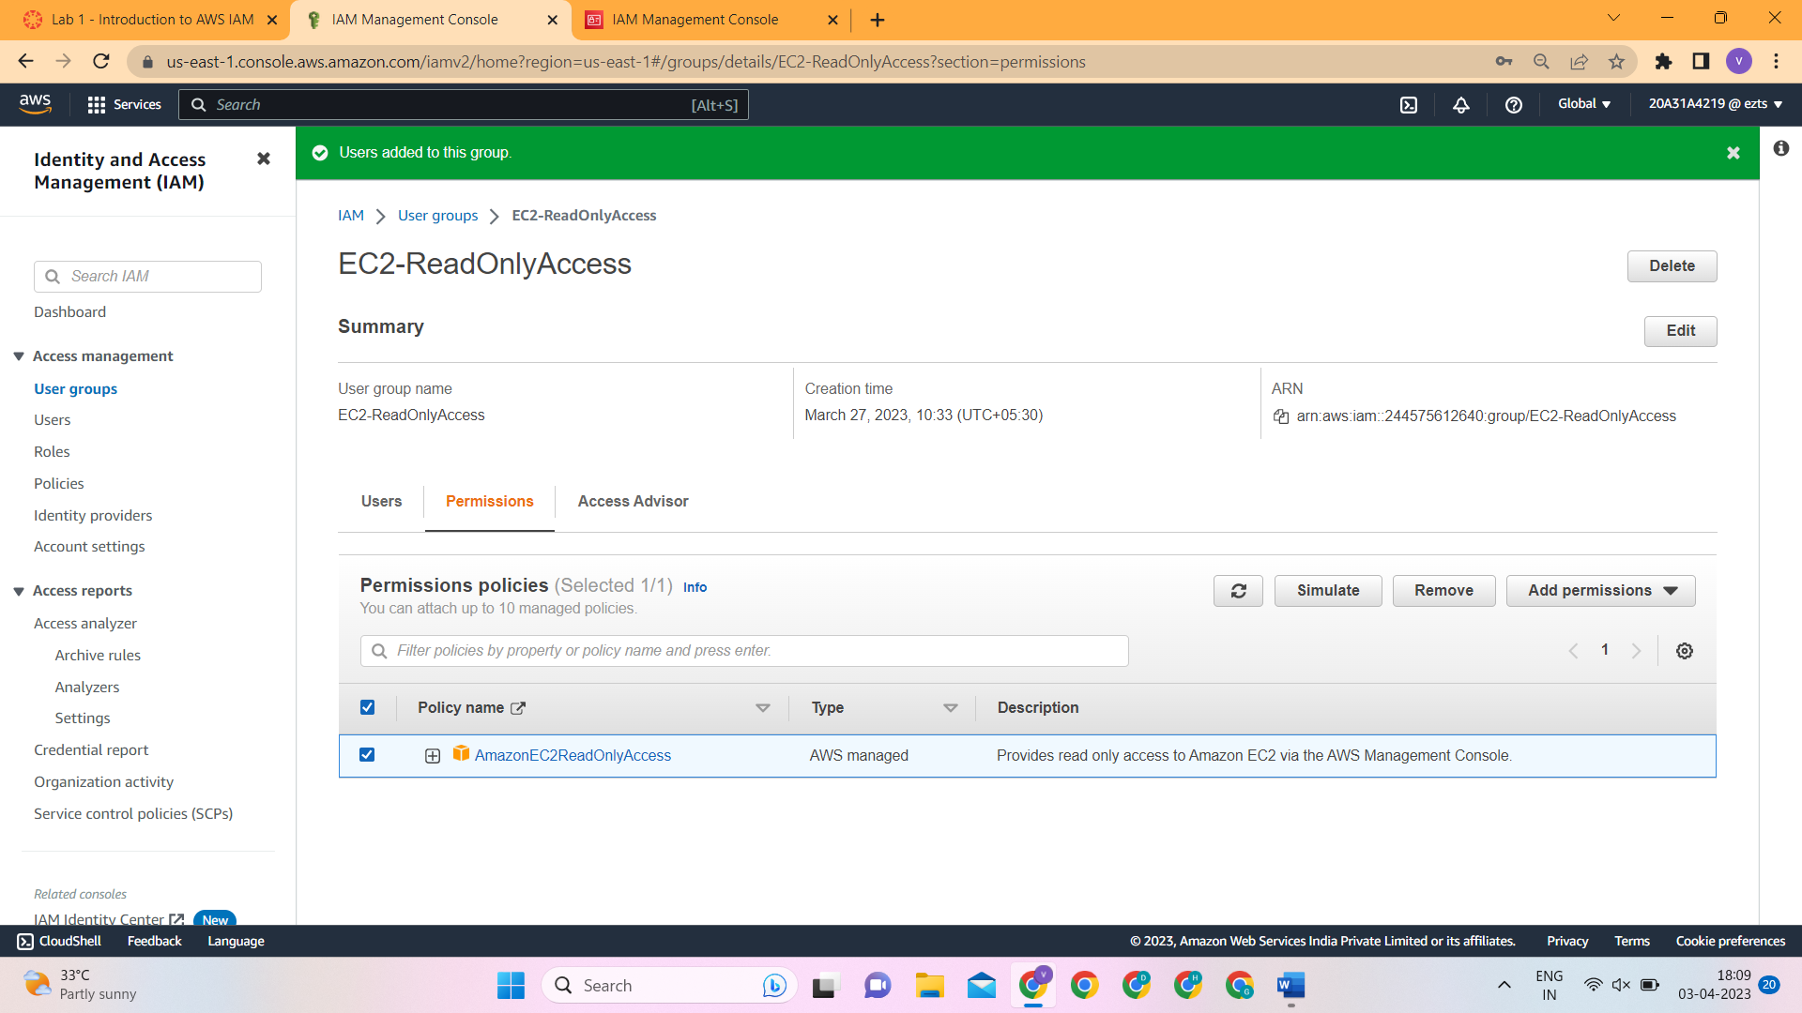
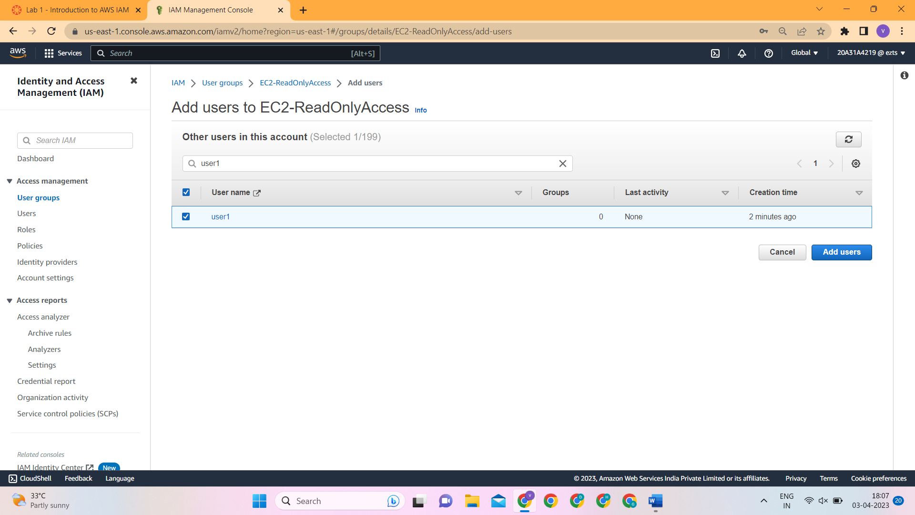
Task 2: Add Users to Groups
Add user-1 to the EC2-ReadOnlyAccess
Step 1:In the left navigation pane, choose User groups.
Step 2: Choose the EC2-ReadOnlyAccess group.
Step 3: Choose the Users tab.
Step 4: In the Users tab, choose Add users.

Slide 5
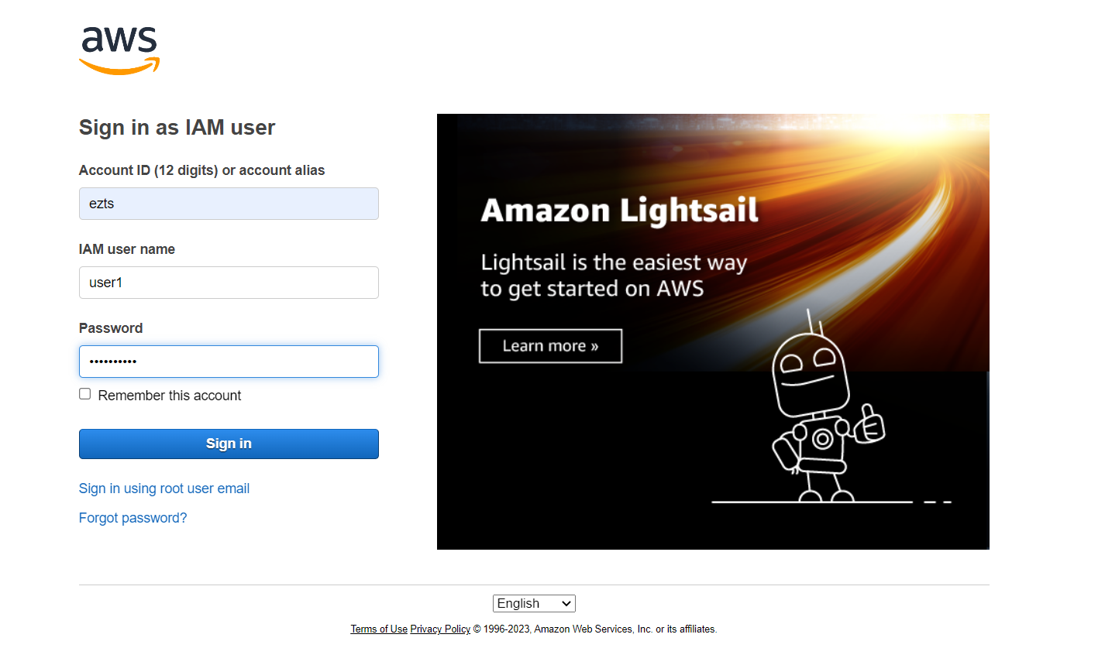
Task 3: Sign-In and Test Users
Step 1: Paste the IAM users sign-in link into the address bar of your private browser session and press Enter.
Next, you will sign-in as user-1, who has been hired as your Amazon S3 storage support staff.
Step 2 : Sign-in with:
IAM user name: user-1
Password: Lab-Password1
Step 3 : Click sign in
Step 4: Set New Password.

Slide 6
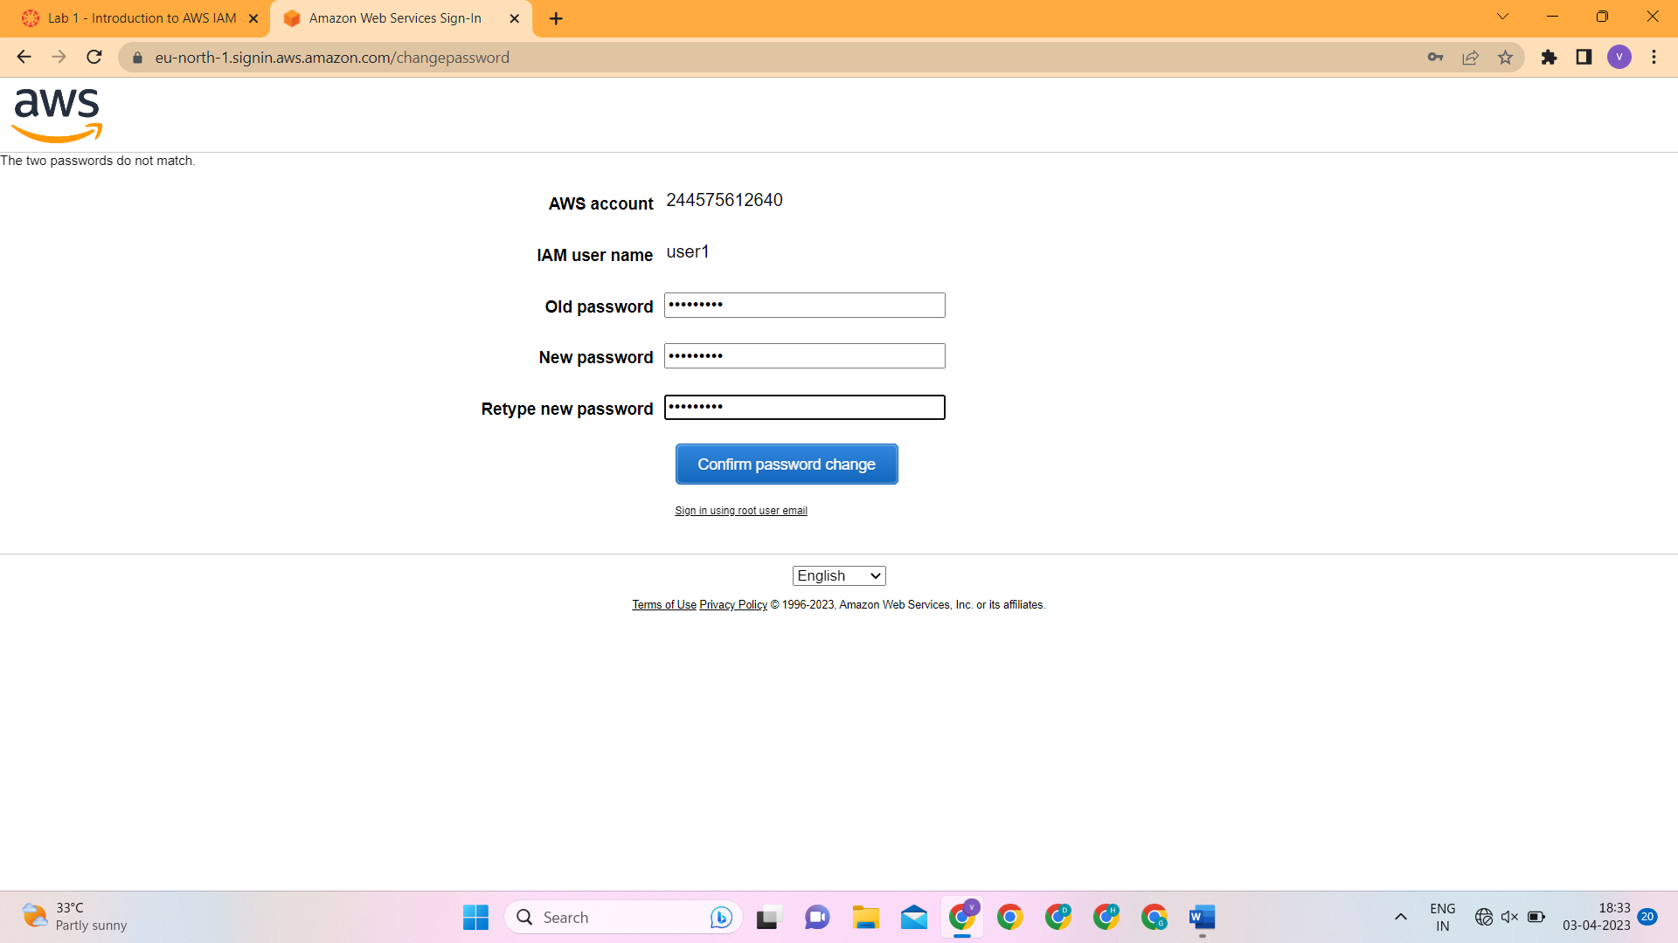
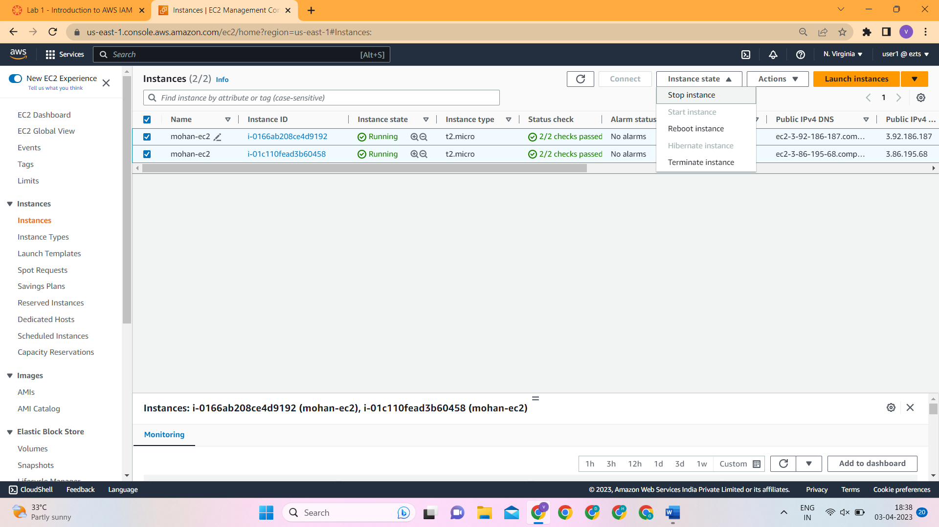
Step 4: In the Services menu, choose EC2.
Step 5: In the navigation pane on the left, choose Instances.
Step 6: In the Instance state menu above, select Stop instance.
Step 7: Choose Sign Out

Slide 7
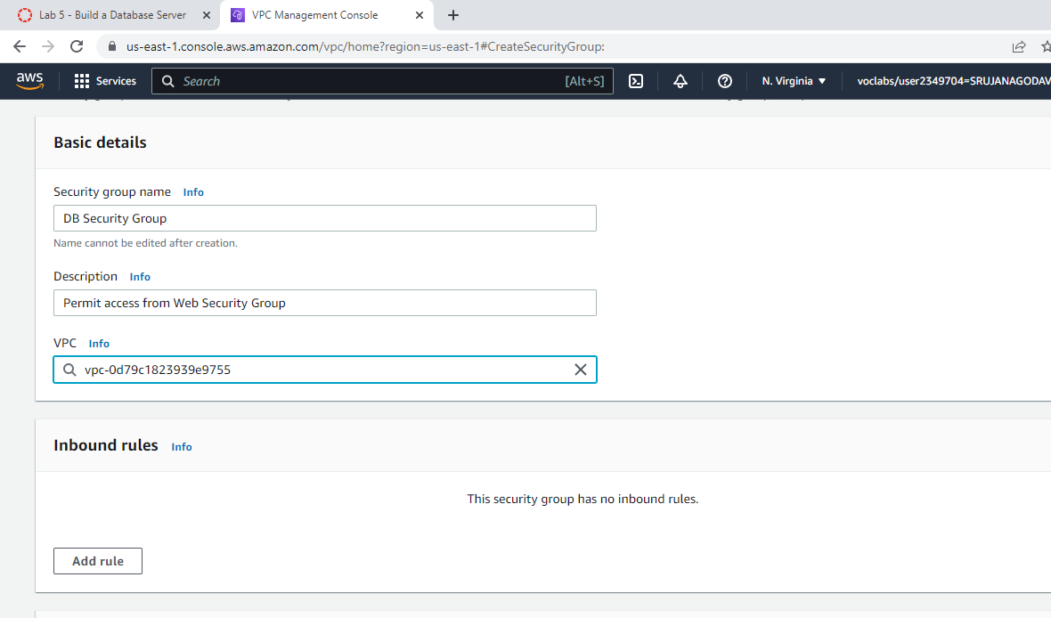
LAB 5:BUILD A DATABASE SERVER
Task 1: Create a Security Group for the RDS DB Instance
Step1: In the AWS Management Console, on the Services menu, choose VPC.
Step2: In the left navigation pane, choose Security Groups.
Step3: Choose Create security group and then configure:
Security group name: DB Security Group
Description: Permit access from Web Security Group
VPC: Lab VPC

Slide 8
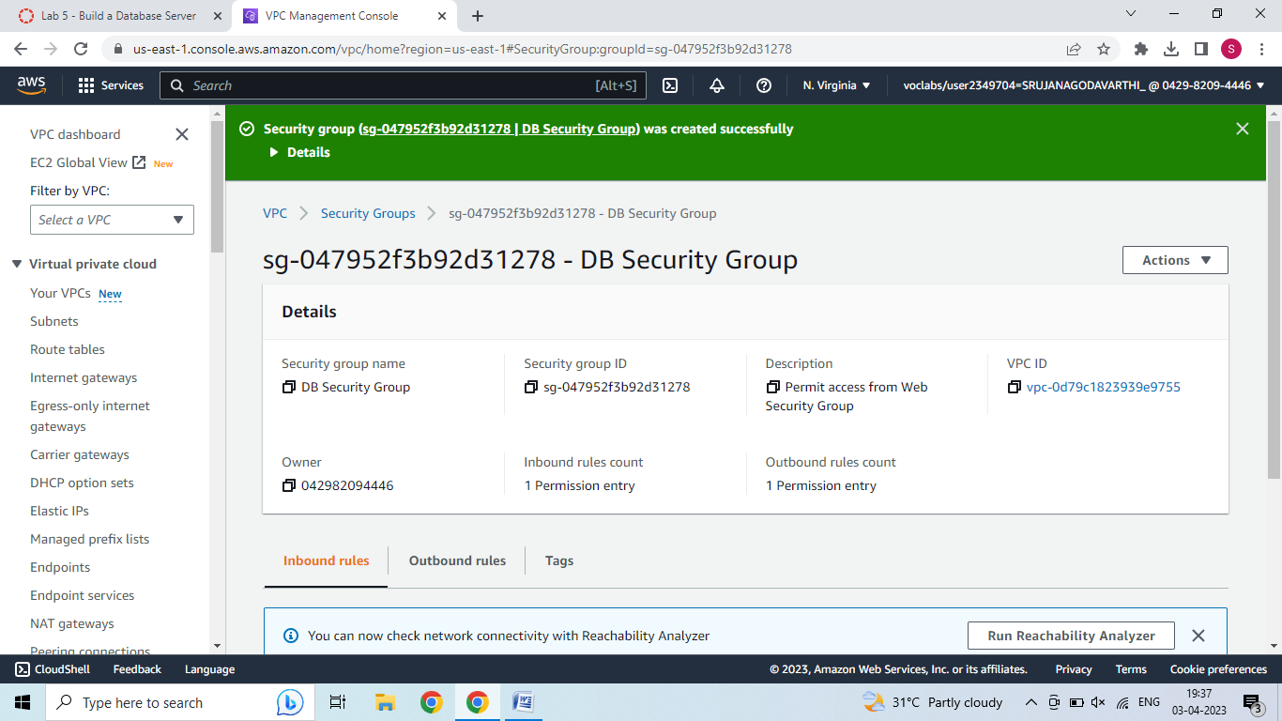
Step4: In the Inbound rules pane, choose Add rule.
Step 5: Configure the following settings:
Type: MySQL/Aurora (3306)
CIDR, IP, Security Group or Prefix List: Type sg and then select Web Security Group.
Step 6: Choose Create security group.
You will use this security group when launching the Amazon RDS database.

Slide 9
Task 2: Create a DB Subnet Group
Step 1: On the Services menu, choose RDS.
Step 2: In the left navigation pane, choose Subnet groups.
If the navigation pane is not visible, choose the menu icon in the top-left corner.
Step 3: Choose Create DB Subnet Group then configure:
Name: DB-Subnet-Group
Description: DB Subnet Group
VPC: Lab VPC
Step 4: Scroll down to the Add Subnets section.
Step 5: Expand the list of values under Availability Zones and select the first two zones: us-east-1a and us-east-1b.
Step 6: Expand the list of values under Subnets and select the subnets associated with the CIDR ranges 10.0.1.0/24 and 10.0.3.0/24.
These subnets should now be shown in the Subnets selected table.
Step 7: Choose Create.

Slide 10
Step 5: Under Storage, configure:
Storage type: General Purpose (SSD)
Allocated storage: 20
Step 6: Under Connectivity, configure:
Virtual Private Cloud (VPC): Lab VPC
Step 7: Under Existing VPC security groups, from the dropdown list:
Choose DB Security Group.
Deselect default.
Step 8: Expand Additional configuration, then configure:
Initial database name: lab
Uncheck Enable automatic backups.
Uncheck Enable encryption
Uncheck Enable Enhanced monitoring.
This will turn off backups, which is not normally recommended, but will make the database deploy faster for this lab.
Step 9: Choose Create database.Your database will now be launched.

Slide 11
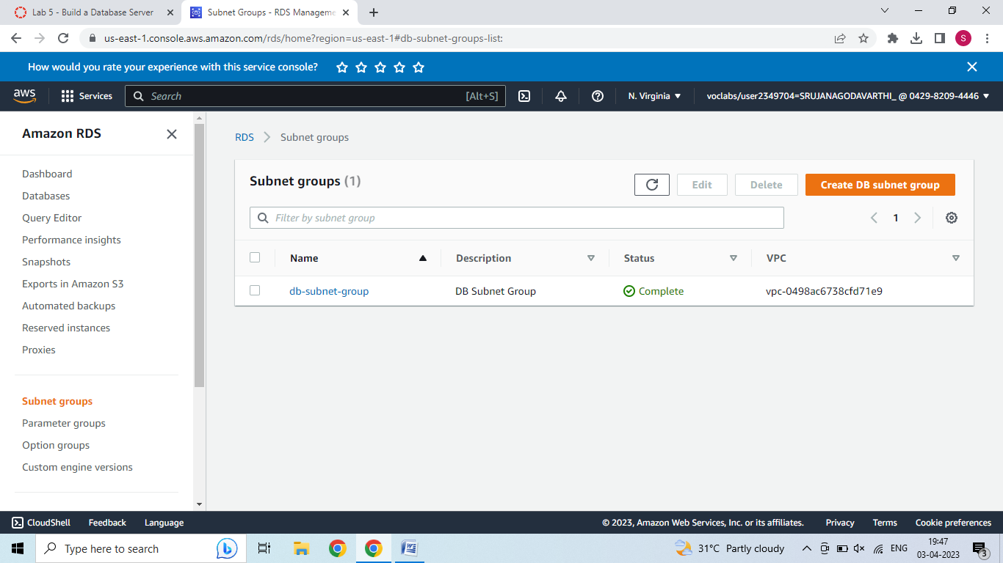
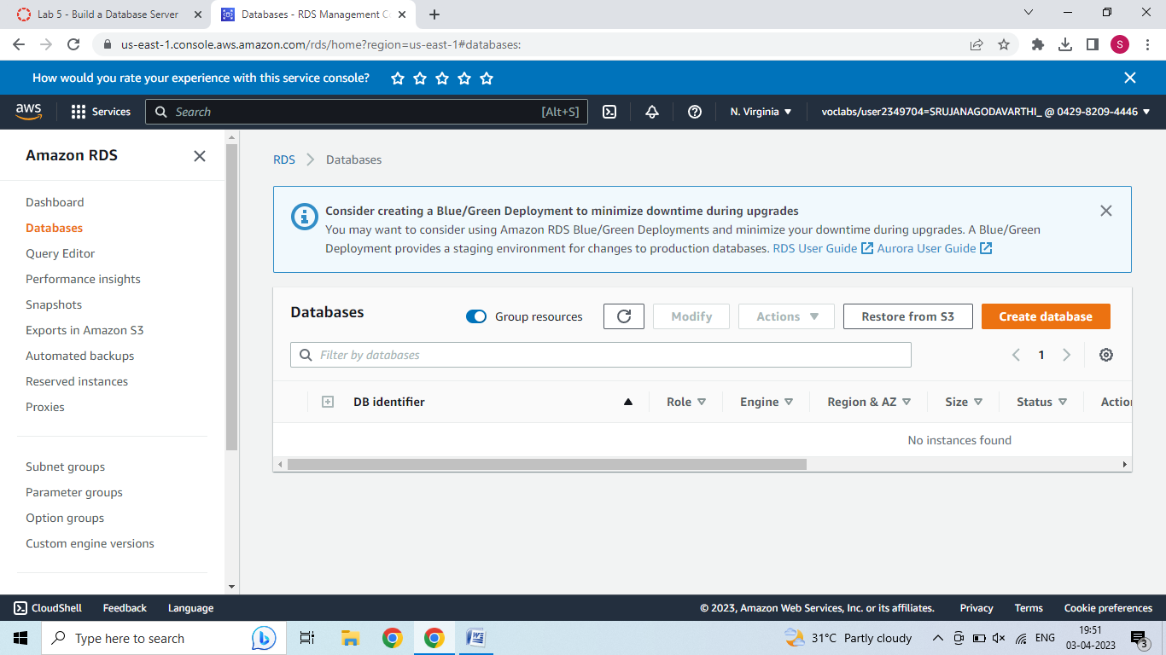
Task 3: Create an Amazon RDS DB Instance
Step 1: In the left navigation pane, choose Databases.

Slide 12
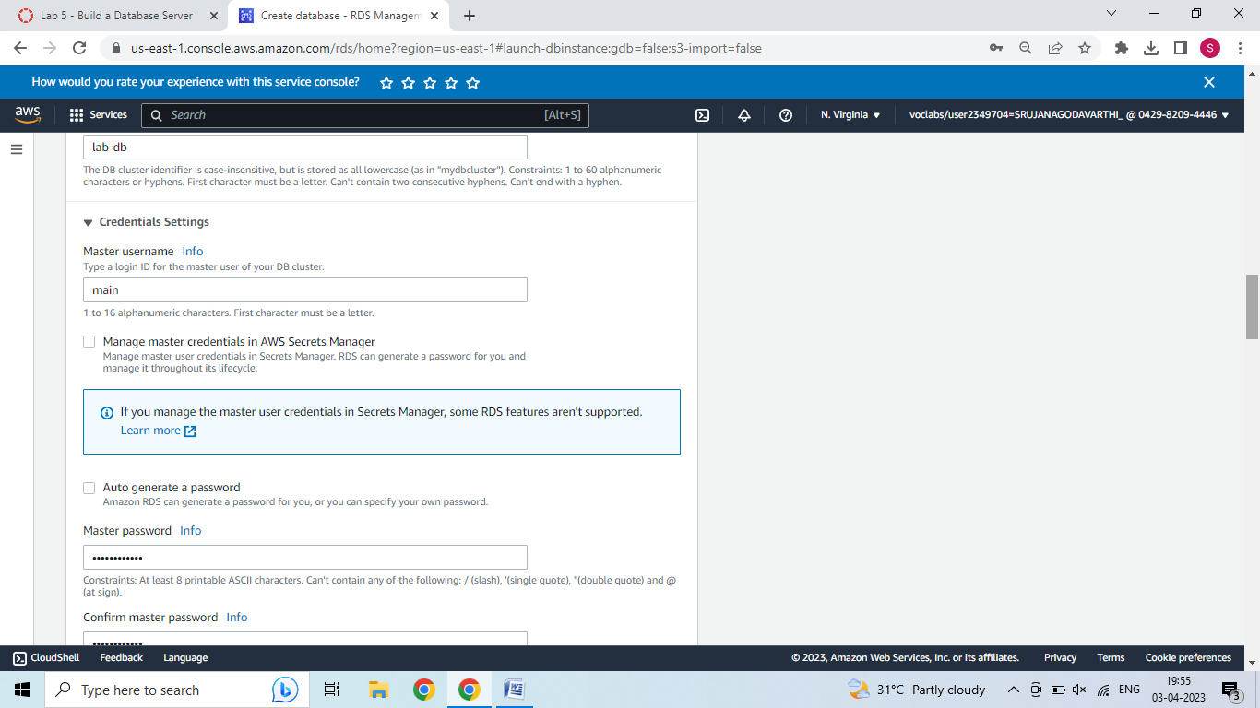
Step 2 : Choose Create database.
If you see Switch to the new database creation flow at the top of the screen, please choose it.
Step 3: Select MySQL.
Step 4: Under Settings, configure:
DB instance identifier: lab-db
Master username: main
Master password: lab-password
Confirm password: lab-password

Slide 13
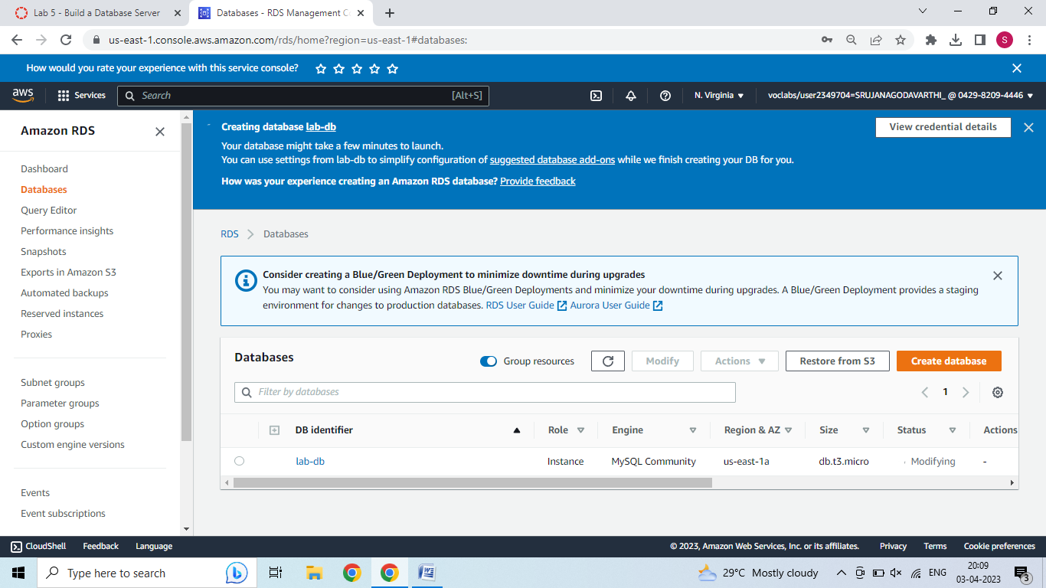
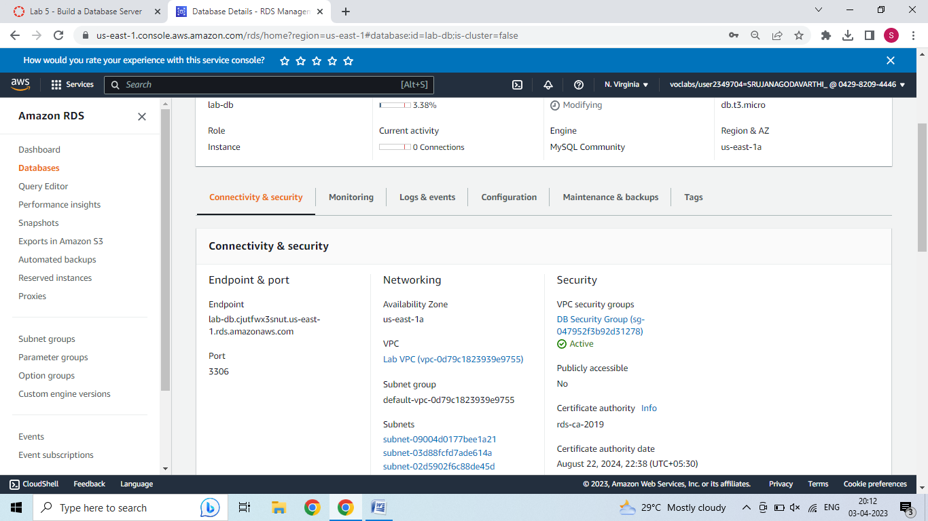
Step 10: Choose lab-db (choose the link itself).
Step 11: Wait until Info changes to Modifying or Available.
Step 12: Scroll down to the Connectivity & security section and copy the Endpoint field.

Slide 14
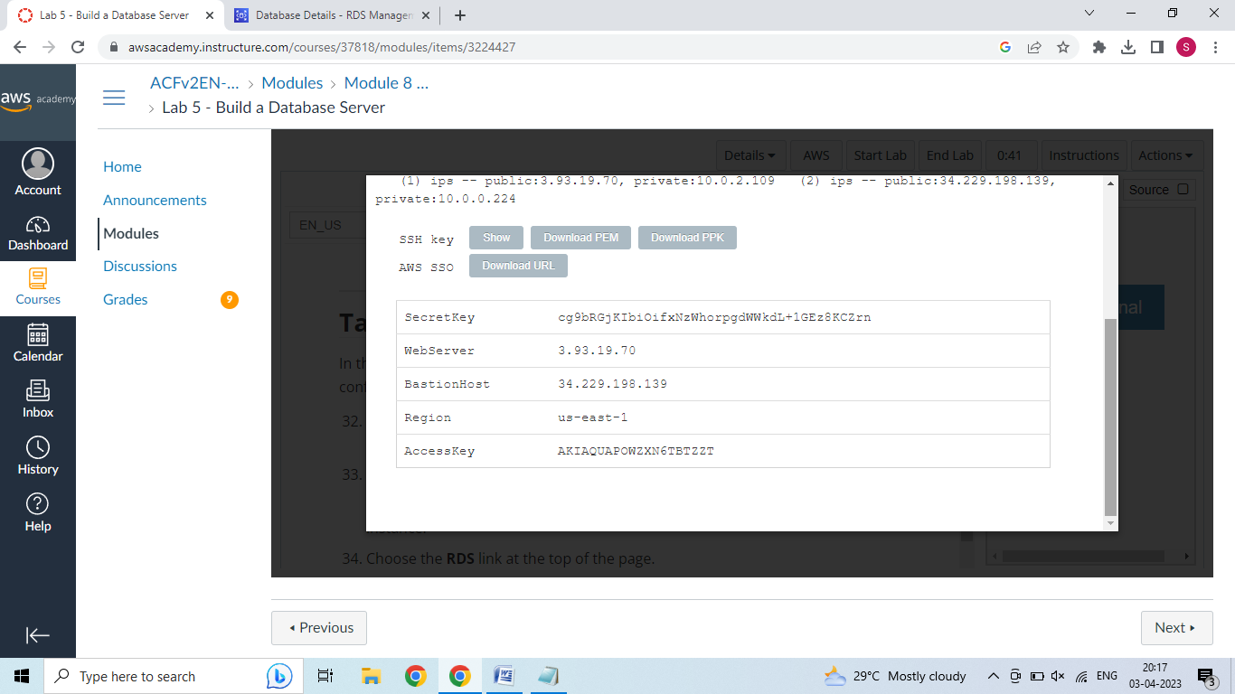
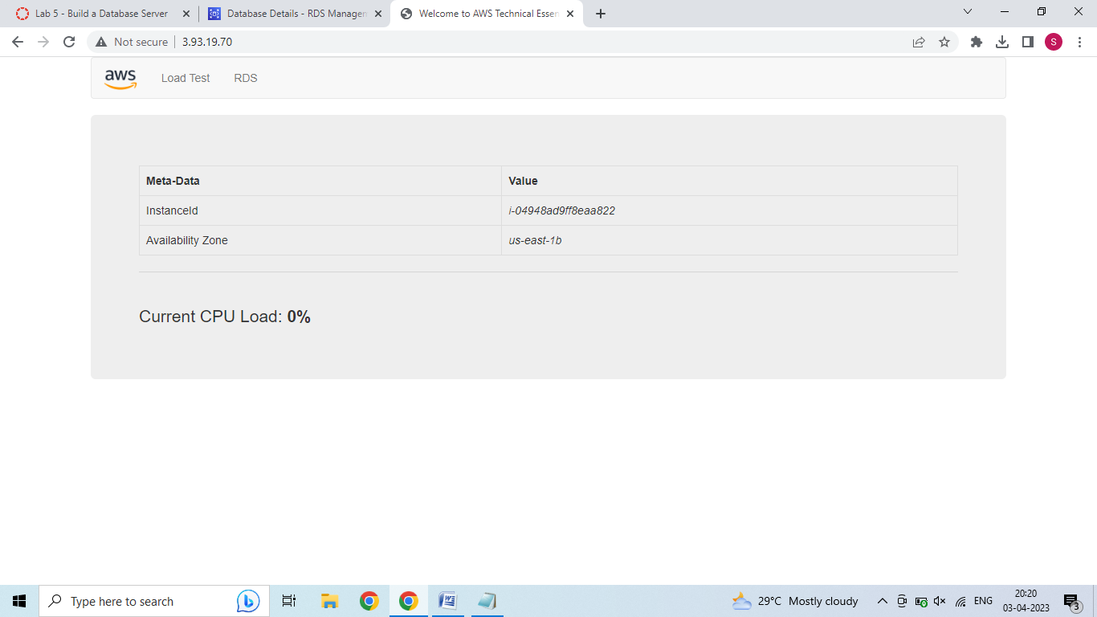
Step 13: Paste the Endpoint value into a text editor. You will use it later in the lab.
Task 4: Interact with Your Database
Step 1: To copy the WebServer IP address, choose on the Details drop down menu above these instructions, and then choose Show.
Step 2: Open a new web browser tab, paste the WebServer IP address and press Enter.
Step 3: Choose the RDS link at the top of the page.
Step 4: Configure the following settings:
Endpoint: Paste the Endpoint you copied to a text editor earlier
Database: lab
Username: main
Password: lab-password
Choose Submit

Slide 15
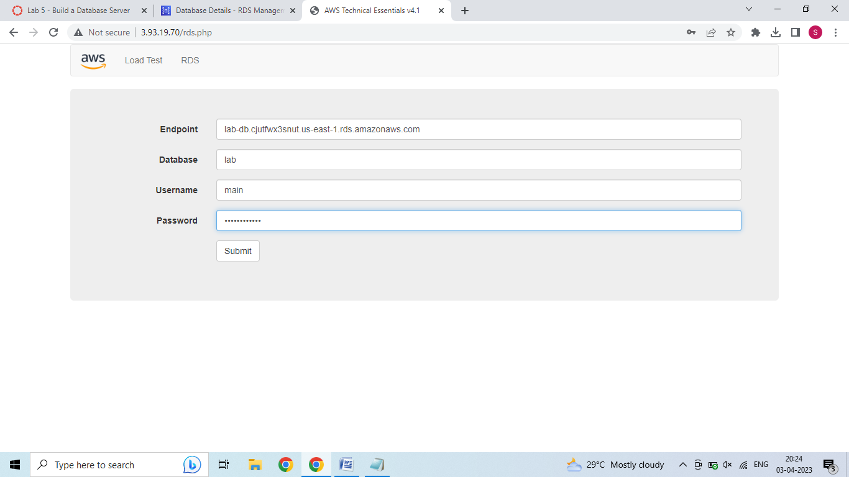
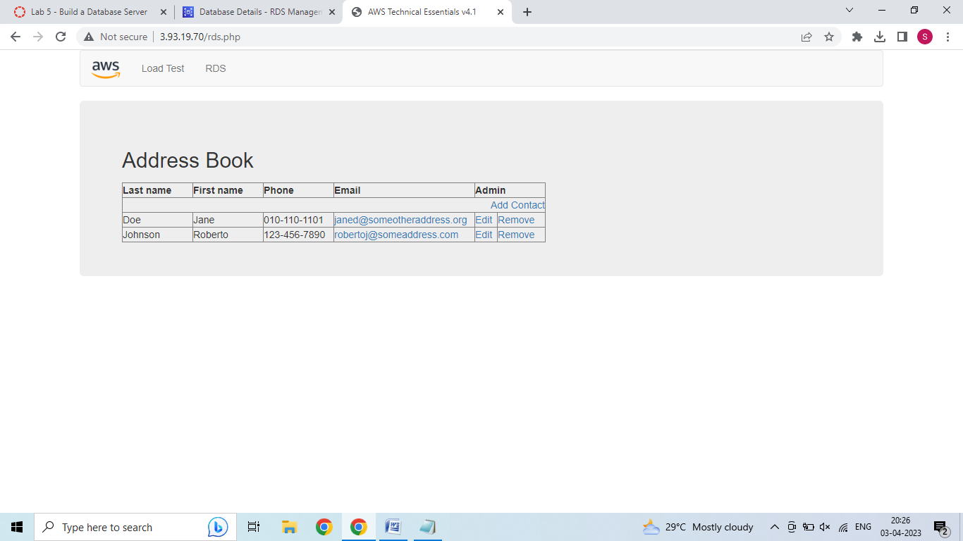
A message will appear explaining that the application is running a command to copy information to the database. After a few seconds the application will display an Address Book.
The Address Book application is using the RDS database to store information.
Step 5: Test the web application by adding, editing and removing contacts.

Slide 16
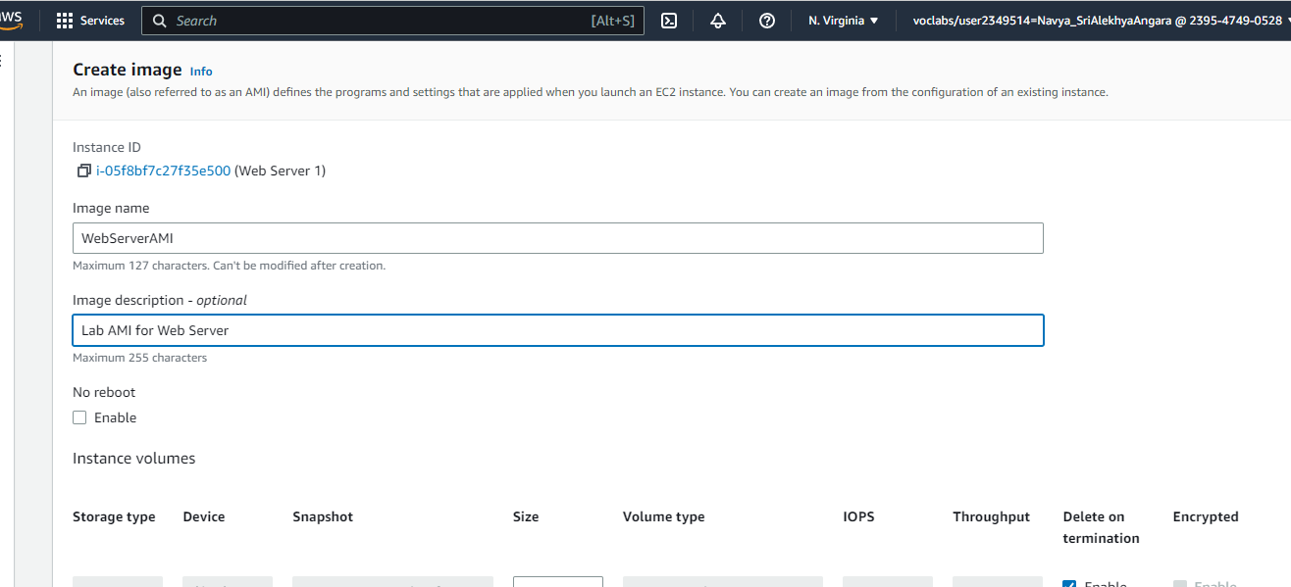
Lab 6: Scale and Load Balance Your Architecture
Task 1: Create an AMI for Auto Scaling
Step 1 : In the AWS Management Console, on the services menu, click EC2.
Step 2 : In the left navigation pane, click Instances.
Step 3 : First, you will confirm that the instance is running. Wait until the Status Checks for Web Server 1 displays 2/2 checks passed. Click refresh to update.
Step 3 : Select Web Server 1
Step 4 : In the Actions menu, click Image and templates > Create image, then configure:
Image name: WebServerAMI
Image description: Lab AMI for Web Server

Slide 17
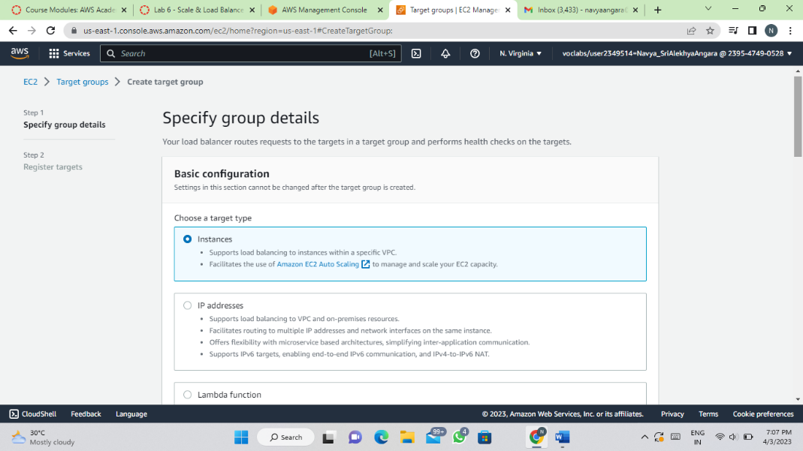
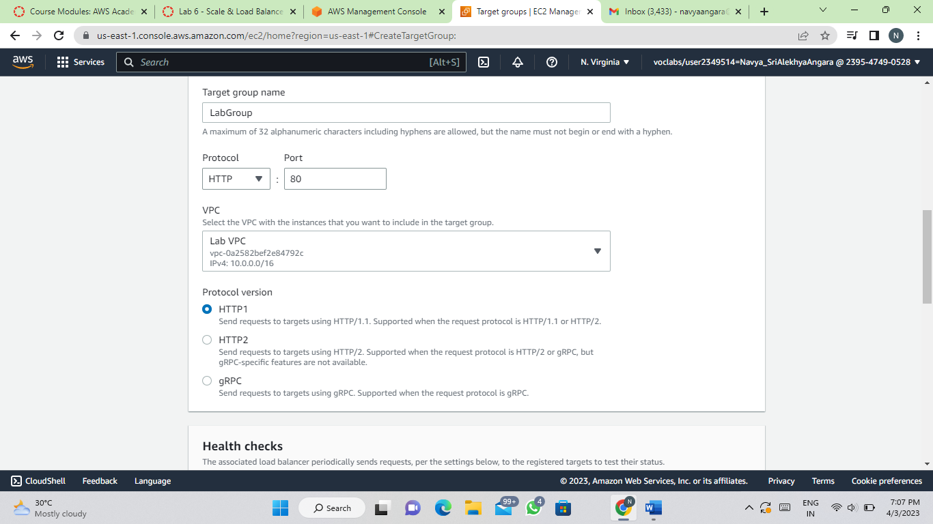
Step 5 : Click Create Image
Task 2: Create a Load Balancer
Step 1 : In the left navigation pane, choose Target Groups.
Choose Create Target Group
Choose a target type: Instances
Target group name, enter: LabGroup
Select Lab VPC from the VPC drop-down menu.
Step 2 : Choose Next. The Register targets screen appears.

Slide 18
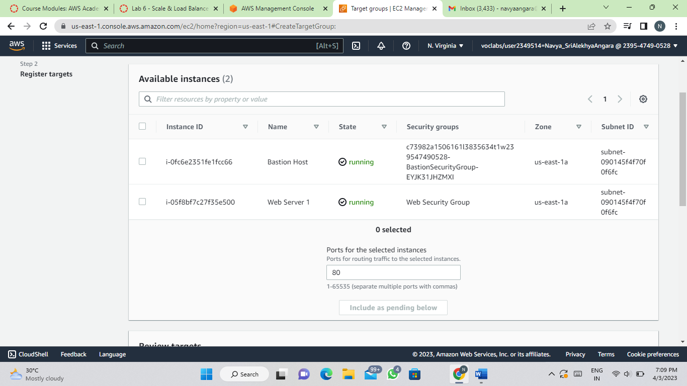
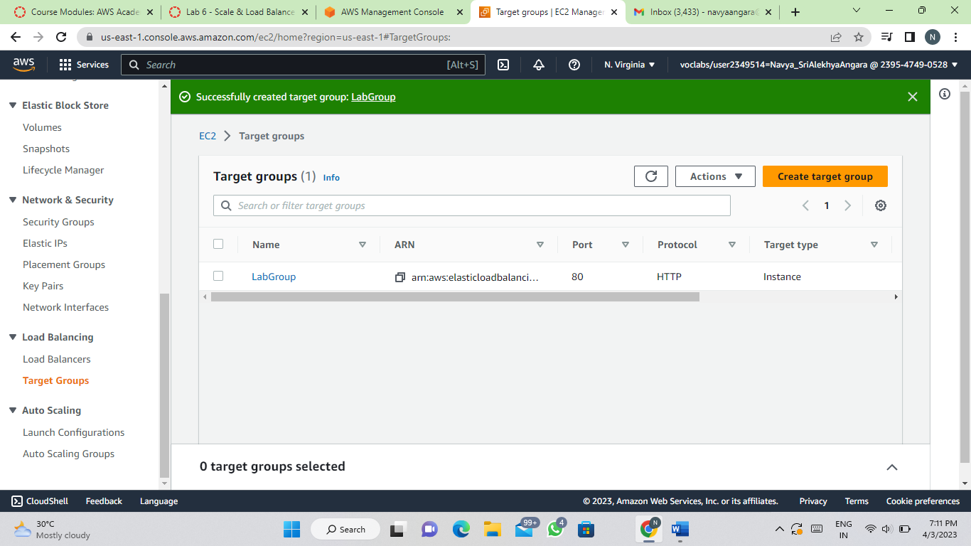
Step 3 : Review the settings and choose create target group.

Slide 19
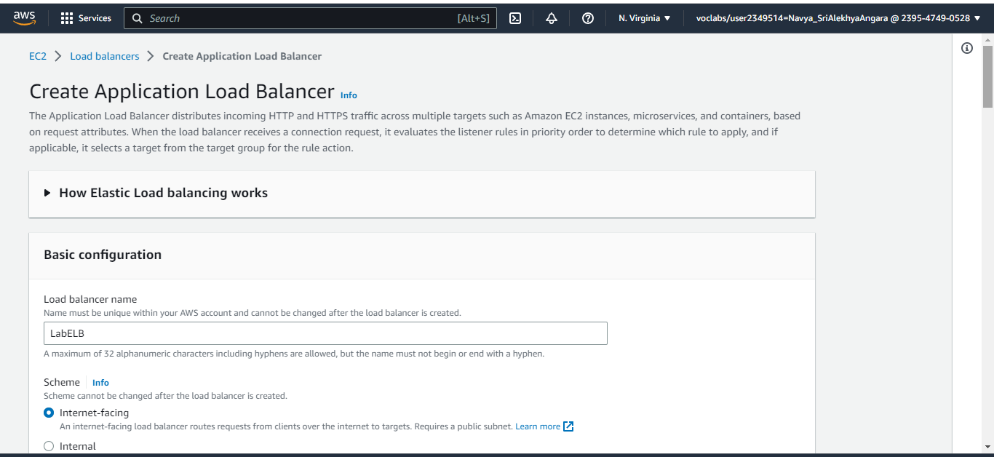
Step 4 : In the left navigation pane, click Load Balancers.
Step 5 : At the top of the screen, choose create Load Balancer.
Step 6 : Under Application Load Balancer, choose Create
Step 7 : Under Load balancer name, enter: LabELB
Step 8 : Scroll down to the Network mapping section, then:
For VPC, select: Lab VPC
Step 9: Choose the first displayed Availability Zone, then select Public Subnet 1, for Second Availability Zone select Public Subnet 2.

Slide 20
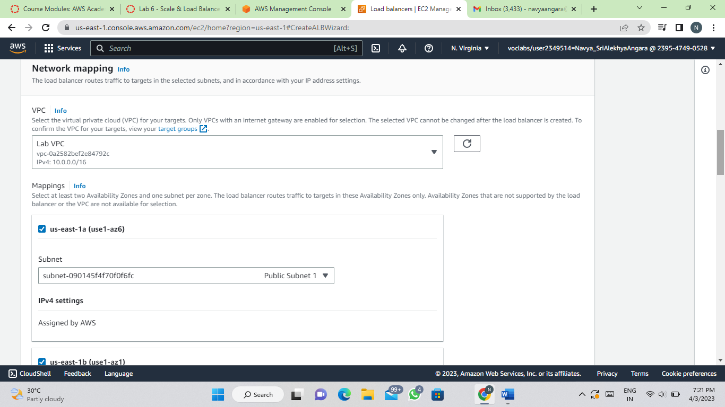
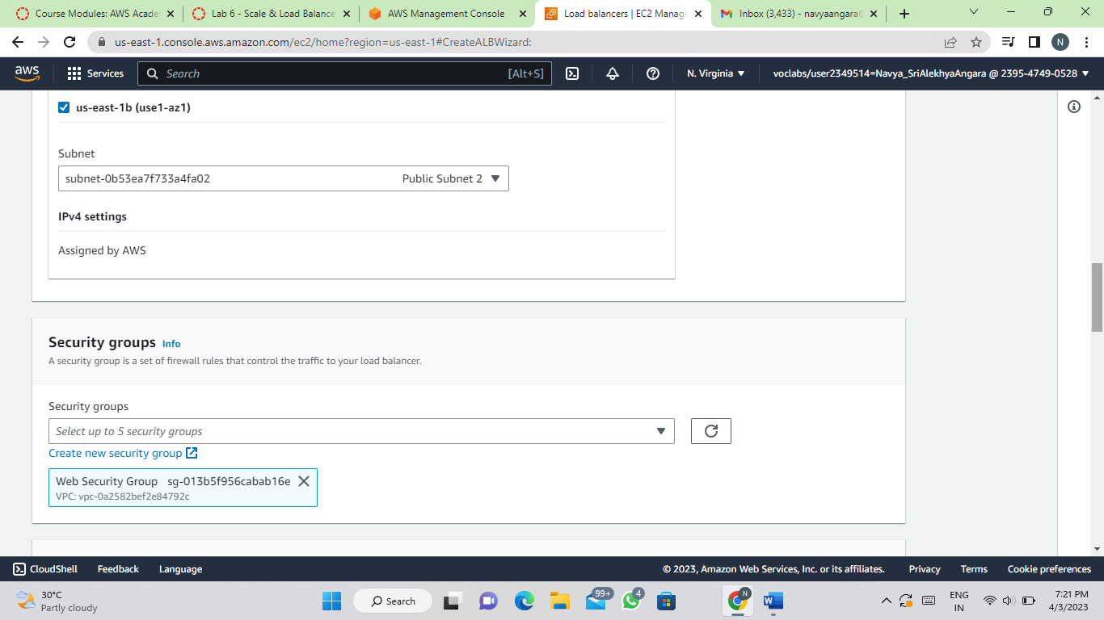
Step 10: In the Security groups section: Select Web Security Group
Step 11: For the Listener HTTP:80 row, set the Default action to forward to LabGroup.

Slide 21
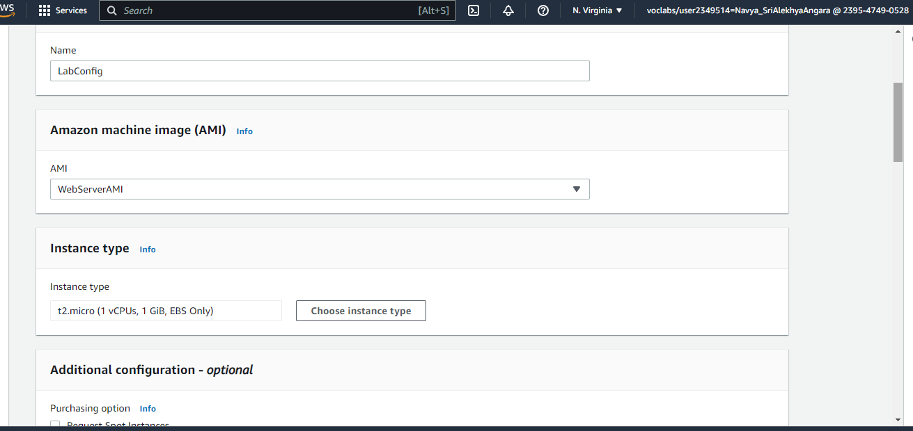
Step 12 : Scroll to the bottom and choose Create load balancer.
Task 3: Create a Launch Configuration and an Auto Scaling Group
Step 1 : In the left navigation pane, click Launch Configurations.
Step 2 : Click Create Launch Configuration.
Step 3 : Configure these settings:
Launch configuration name: LabConfig
Amazon Machine Image (AMI) Choose Web Server AMI
Instance type:
Choose choose instance type
Select t3.micro
Choose choose
If you have launched the lab in the us-east-1 Region, select the t2.micro

Slide 22
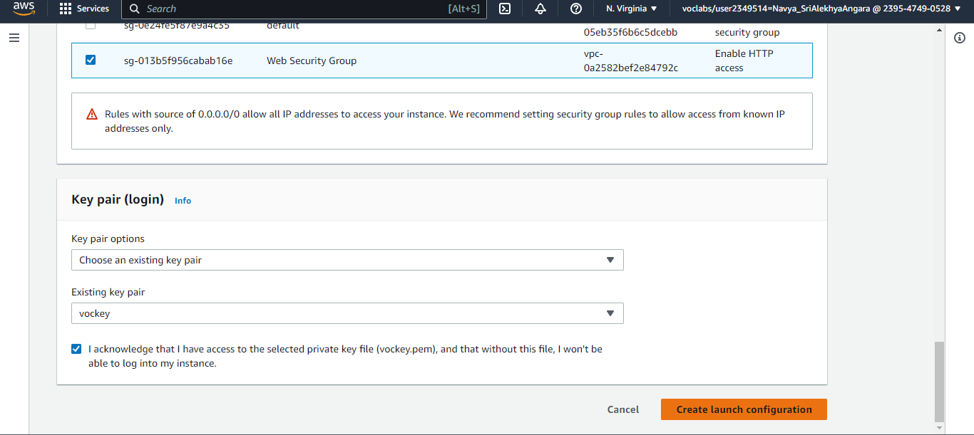
Additional configuration
Monitoring: Select Enable EC2 instance detailed monitoring within CloudWatch
Under Security groups,
Choose Select an existing security group
Select Web Security Group
Under Key pair configure:
Key pair options: Choose an existing key pair
Existing key pair: vockey
Select I acknowledge...
Click Create Launch Configuration.

Slide 23
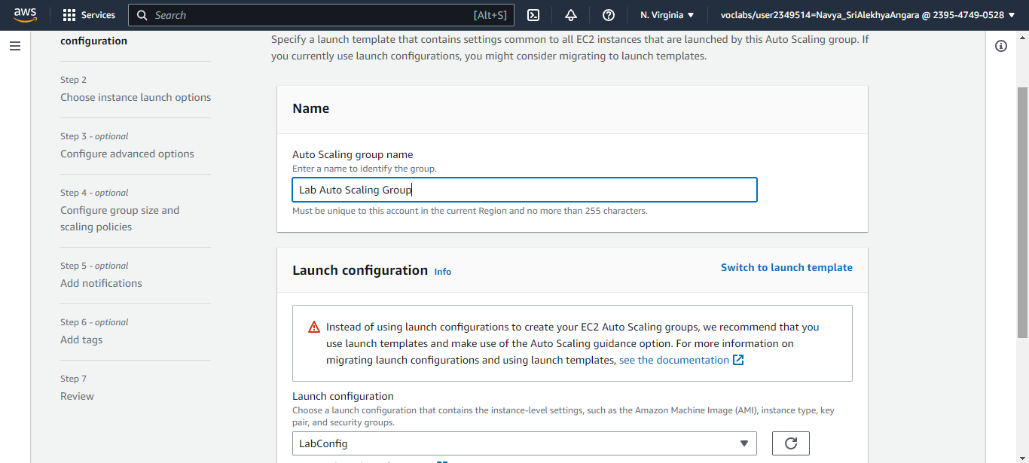
Step 4: Select the checkbox for the LabConfig Launch Configuration.
Step 5 : From the Actions menu, choose Create Auto Scaling group.
Step 6 : Enter Auto Scaling group name:
Name: Lab Auto Scaling Group
Step 7 : Choose Next.
Step 8 : On the Network page configure
Network: Lab VPC
Subnet: Select Private Subnet 1 (10.0.1.0/24) and Private Subnet 2 (10.0.3.0/24)
Step 9 : Choose Next.

Slide 24
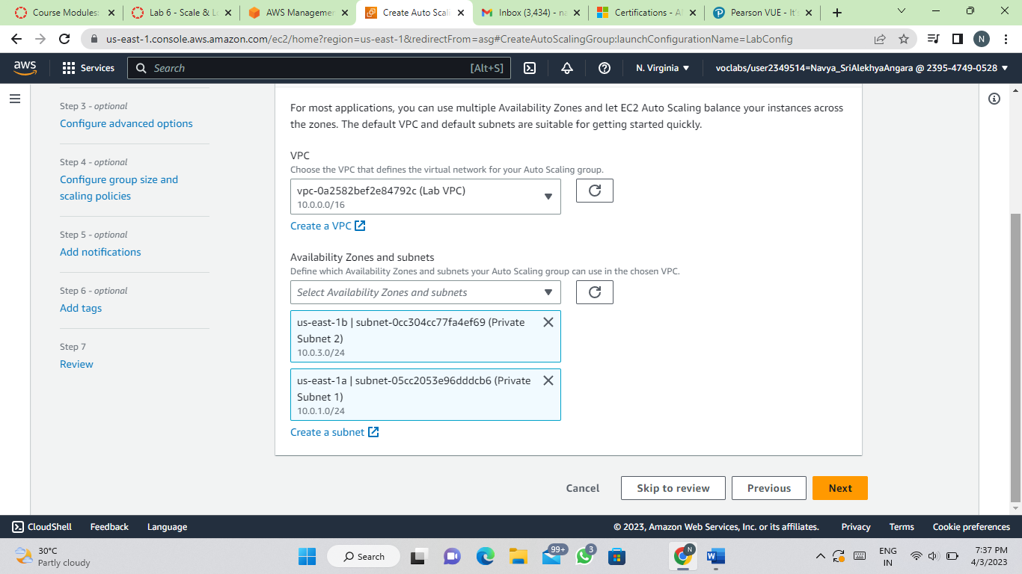
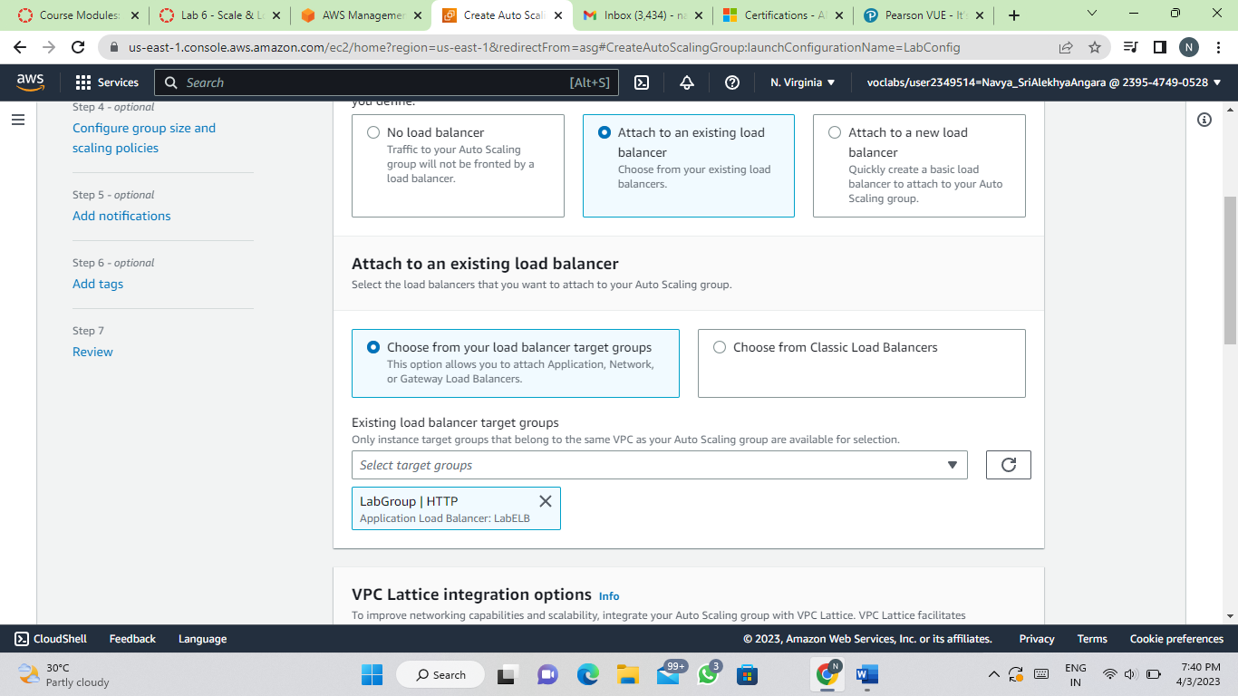
Step 10 : In the Load balancing - optional pane, choose Attach to an existing load balancer
Step 11 : In the Attach to an existing load balancer pane, use the dropdown list to select LabGroup.

Slide 25
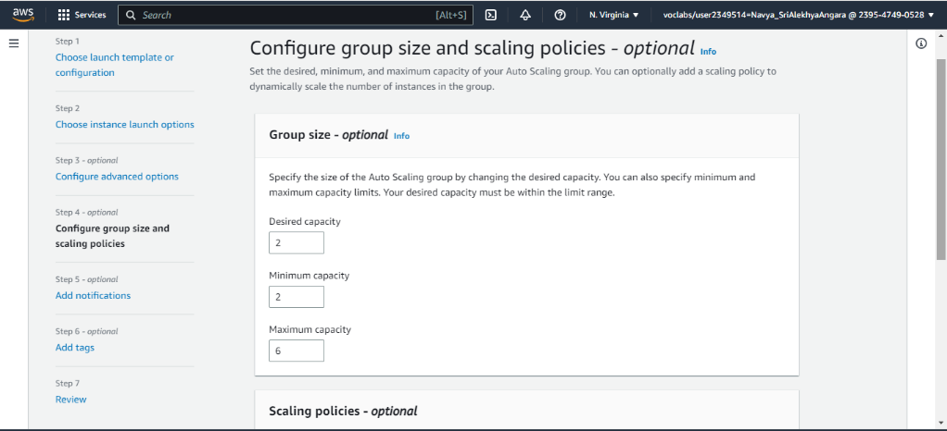
Step 12 : In the Additional settings - optional pane, select Enable group metrics collection within CloudWatch
Step 13 :Choose Next.
Step 14 : Under Group size, configure:
Desired capacity: 2
Minimum capacity: 2
Maximum capacity: 6
Step 15 : Under Scaling policies, choose Target tracking scaling policy and configure:
Lab policy name: LabScalingPolicy
Metric type: Average CPU Utilization
Target value: 60

Slide 26
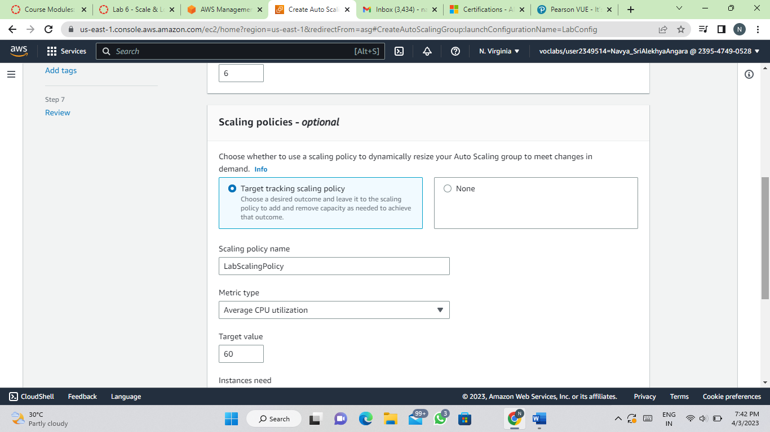
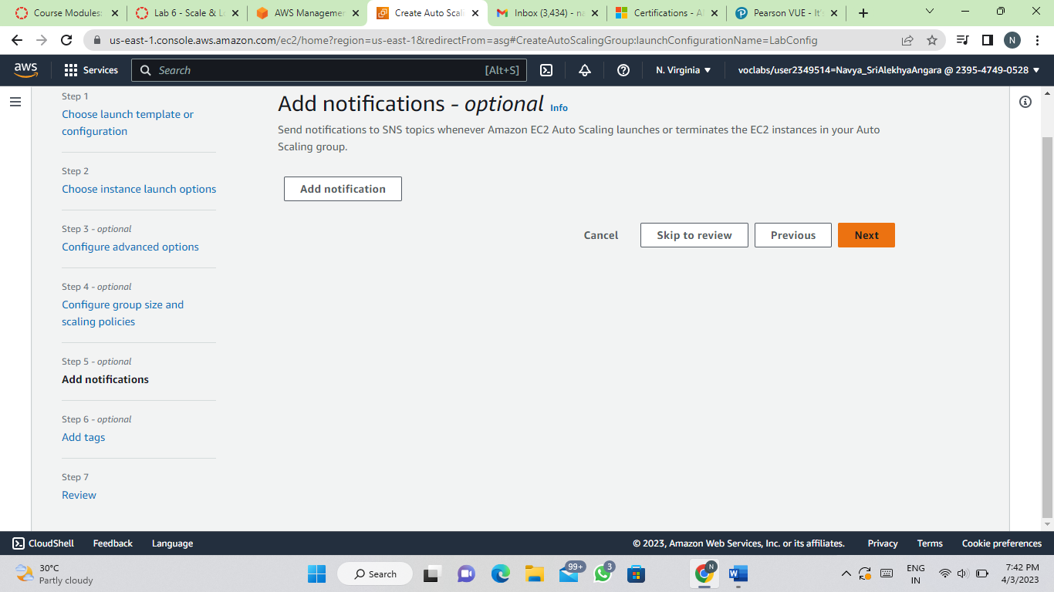
Step 16 : Choose Next
Step 17 : Choose Next
Step 18 : Choose Tag
Key: Name
Value: Lab Instance

Slide 27
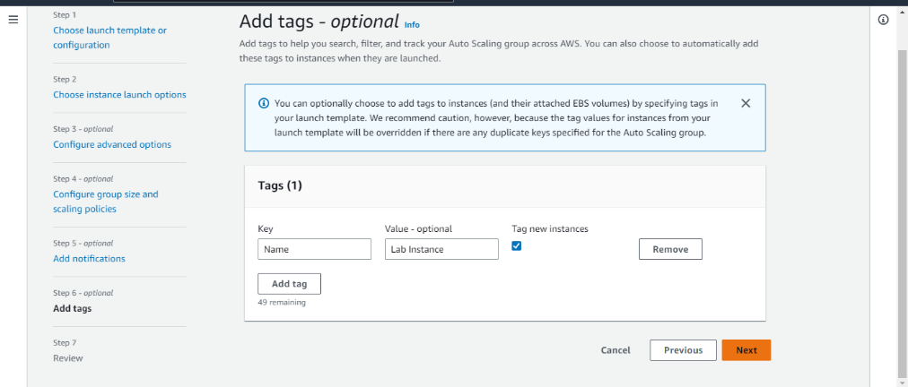
Step 19 : Click Next.
Step 20 : Review the details of your Auto Scaling group, then click Create Auto scaling Group
Task 4: Verify that Load Balancing is Working
Step 1 : In the left navigation pane, click Instances.(You should see two new instances named Lab Instance.)
Step 2 : In the left navigation pane, click Target Groups (in the Load Balancing section).
Step 3 : Choose LabGroup
Step 4 : Click the Targets tab.(Two Lab Instance targets should be listed for this target group.)
Step 5 : Wait until the Status of both instances transitions to healthy
Step 6 : In the left navigation pane, click Load Balancers.
Step 7 : In the lower pane, copy the DNS name of the load balancer, making sure to omit "(A Record)".

Slide 28
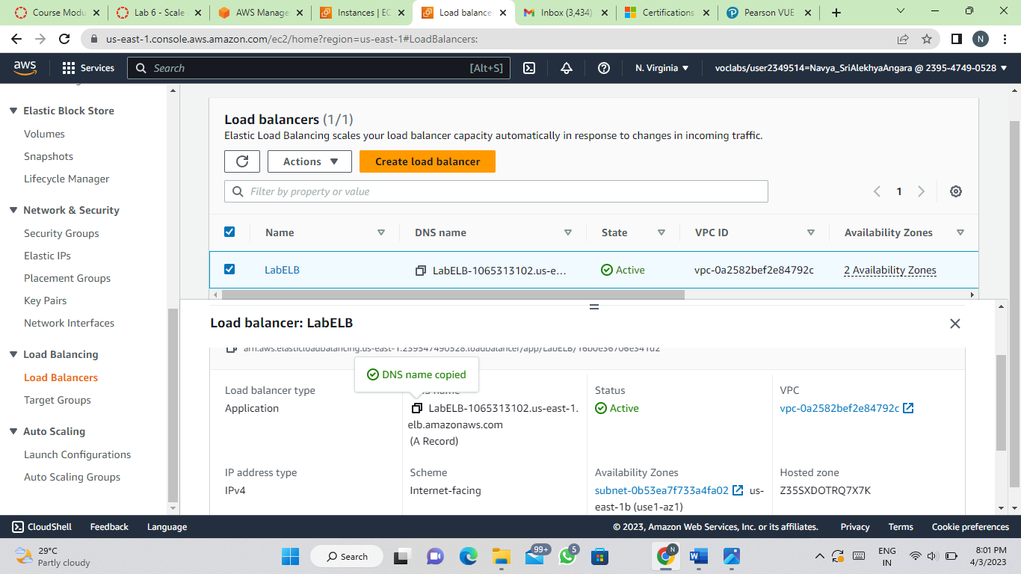
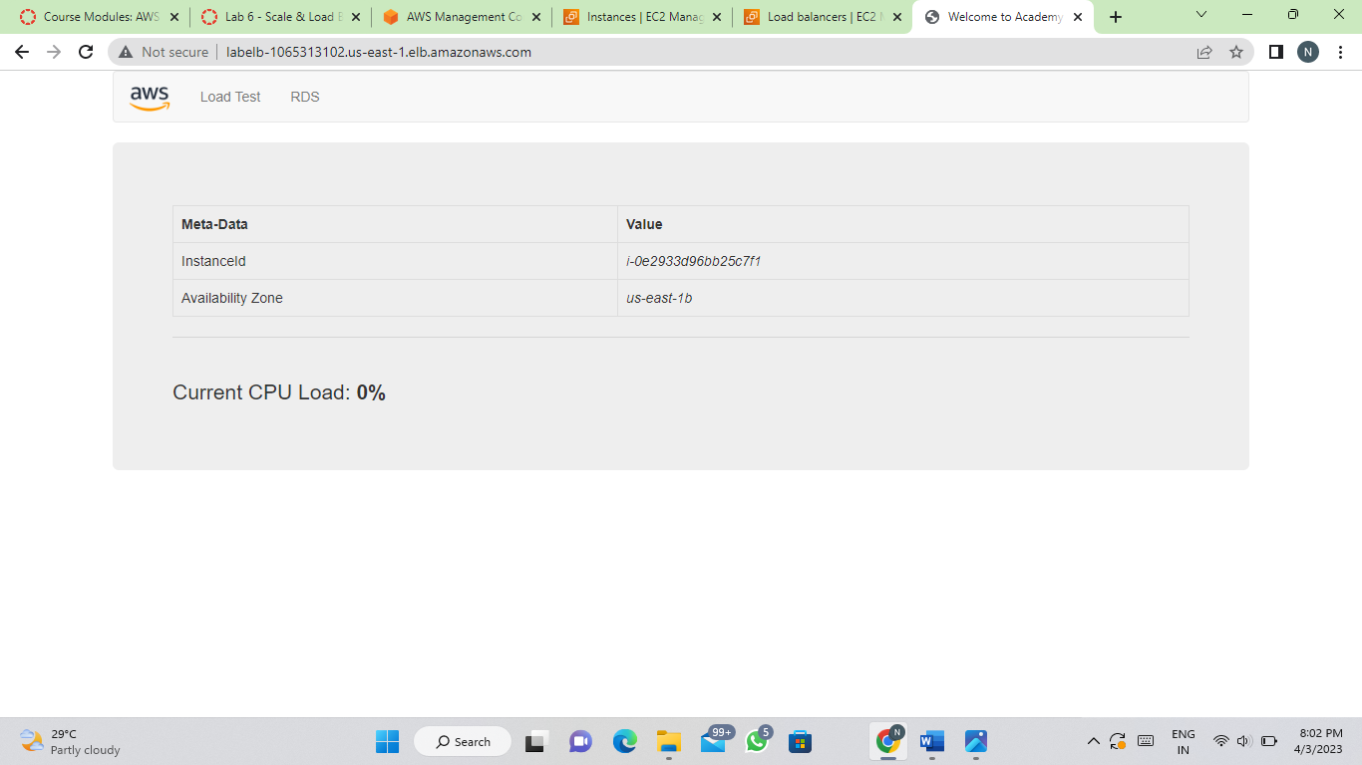
Step 8 : Open a new web browser tab, paste the DNS Name you just copied, and press Enter.

Slide 29
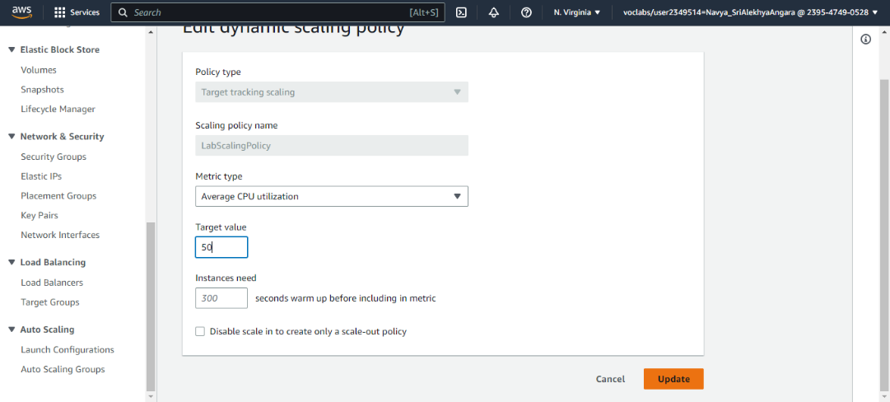
Task 5: Test Auto Scaling
Step 1 :
On the services menu, click EC2.
In the left navigation pane, choose Auto Scaling Groups.
Select Lab Auto Scaling Group.
In the bottom half of the page, choose the Automatic Scaling tab.
Select LabScalingPolicy.
Click Actions and Edit.
Change the Target Value to 50.
Click Update.

Slide 30
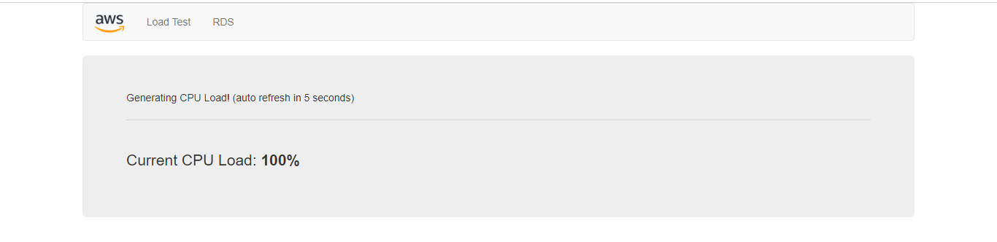
Step 2 : On the Services menu, click CloudWatch.
In the left navigation pane, click All alarms and verify you see two alarms.
Step 3 : Click the OK alarm, which has AlarmHigh in its name.
Step 4 : Return to the browser tab with the web application.
Step 5 : Click Load Test beside the AWS logo.
Step 6 : Return to browser tab with the CloudWatch console.
Step 7 : Wait until the AlarmHigh alarm enters the In alarm state.
Step 8 : On the services menu, click EC2.
Step 9 : In the left navigation pane, click Instances.
(More than two instances labeled Lab Instance should now be running. )

Slide 31
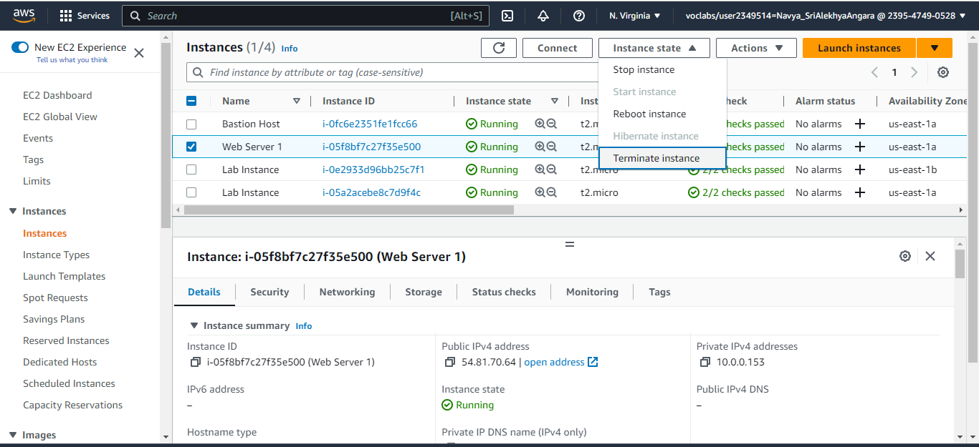
Task 6: Terminate Web Server 1
Step 1 : Select Web Server 1 (and ensure it is the only instance selected).
Step 2 : In the Instance State menu, click Instance State > Terminate Instance.
Step 3 : Choose Terminate
Click End Lab.

Slide 32
LAB 2 :Build your VPC and Launch a Web Server
Task 1: Create Your VPC
Step 1:In the search box to the right of Services, search for and choose VPC to open the VPC console.
Step 2:Begin creating a VPC.
In the top right of the screen, verify that N. Virginia (us- east-1) is the region.
Choose the VPC dashboard link which is also towards the top left of the console.
Next, choose Create VPC.
Step 3:Configure the VPC details in the VPC settings panel on the left:
Choose VPC and more.
Under Name tag auto-generation, keep Auto-generate selected, however change the value from project to lab.
Keep the IPv4 CIDR block set to 10.0.0.0/16
For Number of Availability Zones, choose 1.
For Number of public subnets, keep the 1 setting.
For Number of private subnets, keep the 1 setting.
Expand the Customize subnets CIDR blocks section

Slide 33
Change Public subnet CIDR block in us-east-1a to 10.0.0.0/24
Change Private subnet CIDR block in us-east-1a to 10.0.1.0/24
Set NAT gateways to In 1 AZ.
Set VPC endpoints to None.
Keep both DNS hostnames and DNS resolution enabled.
Step 4:In the Preview panel on the right, confirm the settings you have configured.
VPC: lab-vpc
Subnets: us-east-1a
Public subnet name: lab-subnet-public1-us-east-1a
Private subnet name: lab-subnet-private1-us-east-1a
Route tables
lab-rtb-public
lab-rtb-private1-us-east-1a
Network connections
lab-igw lab-nat-public1-us-east-1a

Slide 34
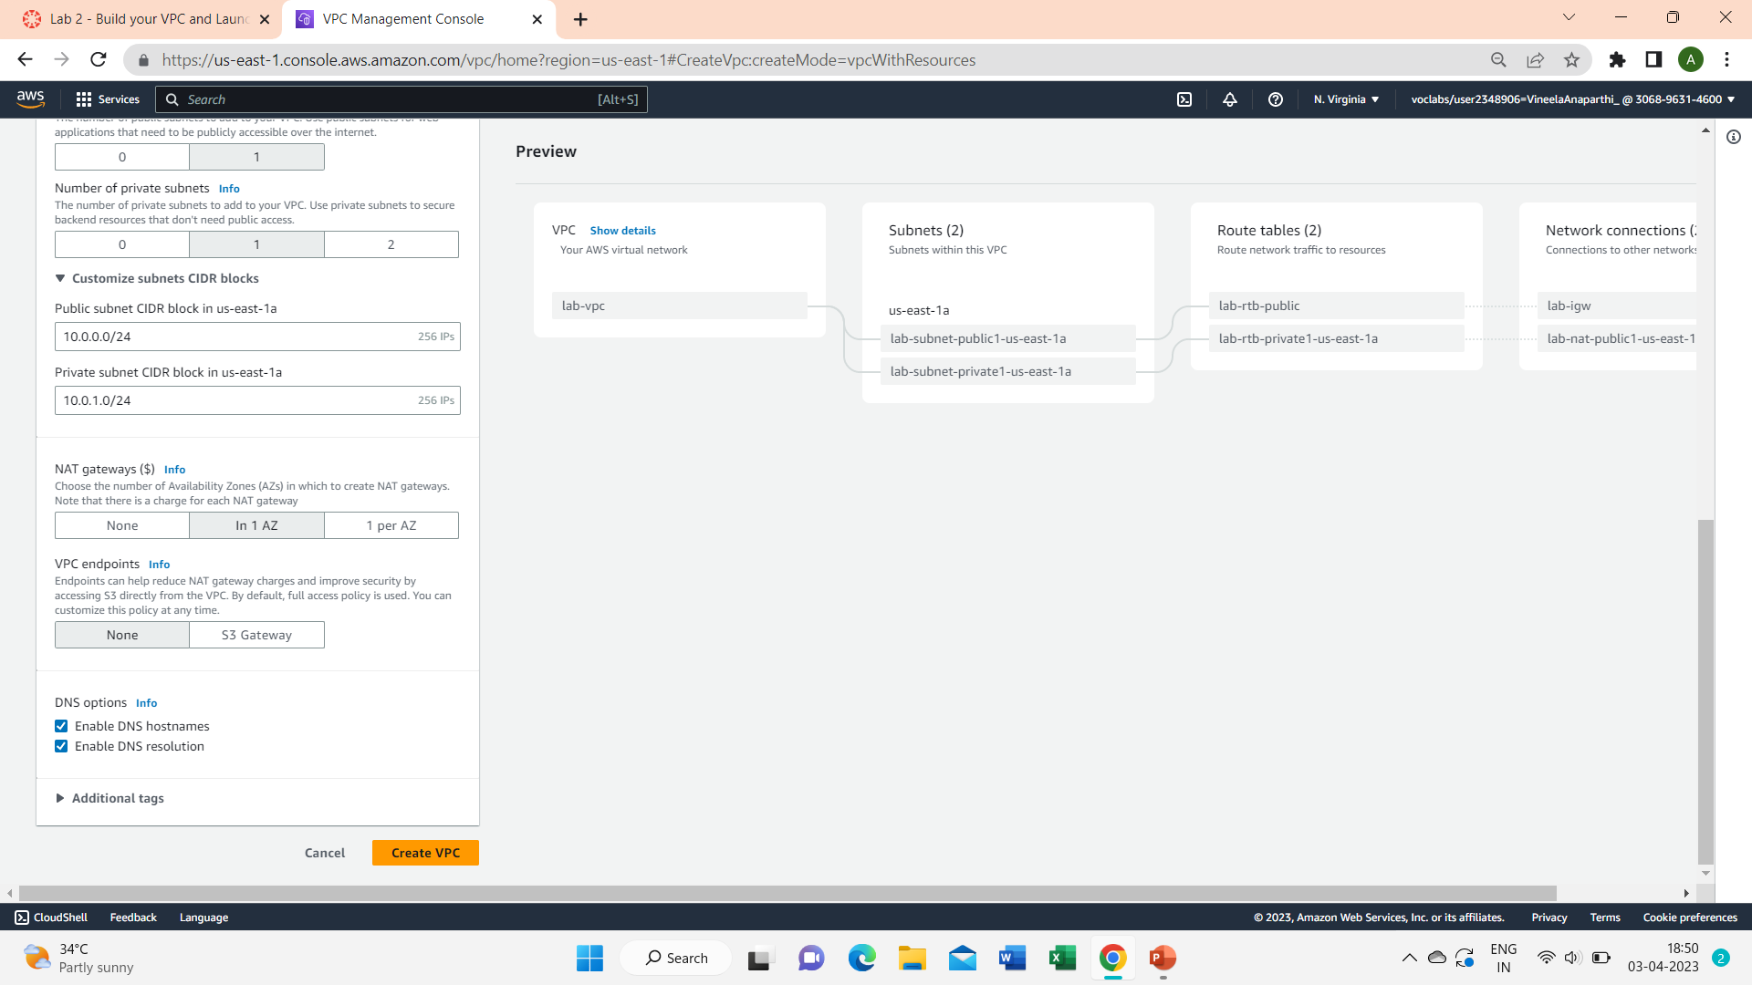
Once it is complete, choose View VPC
View all the VPC resources you have just created
Task 2: Create Additional Subnets
Step 1:In the left navigation pane, choose Subnets.
VPC ID: lab-vpc (select from the menu).
Subnet name:lab-subnet-public2
Availability Zone: Select the second Availability Zone (for example, us-east-1b)
IPV4 CIDR block:10.0.2.0/24

Slide 35
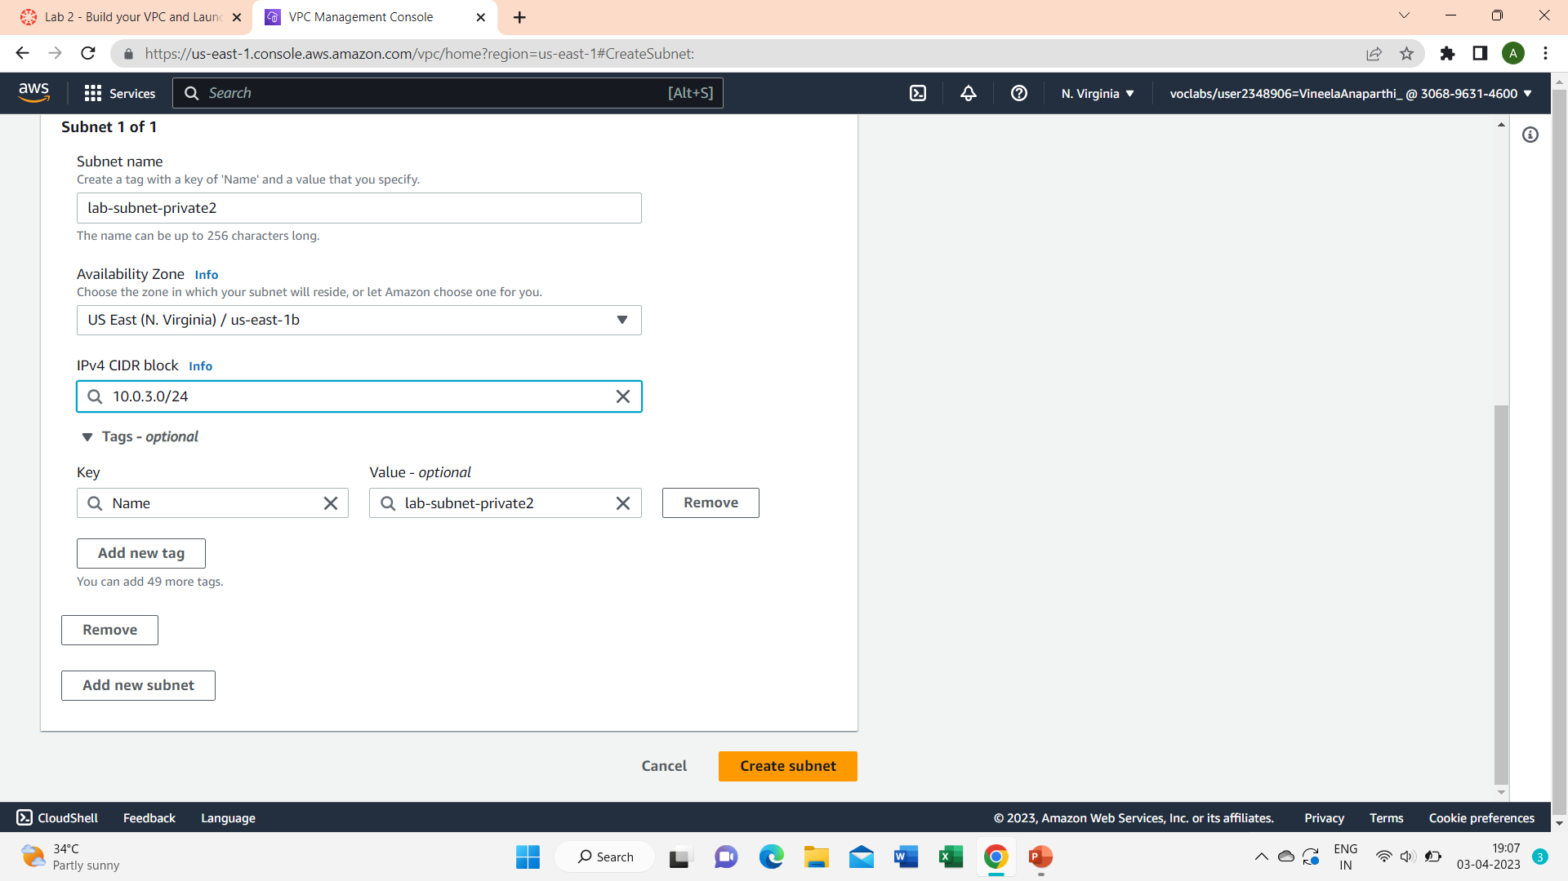
Choose Create subnet
Choose Create subnet then configure:
VPC ID: lab-vpc
Subnet name:lab-subnet-public2
Availability Zone: Select the second Availability Zone (for example, us-east-1b)
IPV4 CIDR block:10.0.2.0/24
Choose Create subnet
Step 2:In the left navigation pane, choose Route tables.
Select the lab-rtb-private1-us-east-1a route table.
In the lower pane, choose the Routes tab.
Choose the Subnet associations tab.
In the Explicit subnet associations panel, choose Edit subnet associations

Slide 36
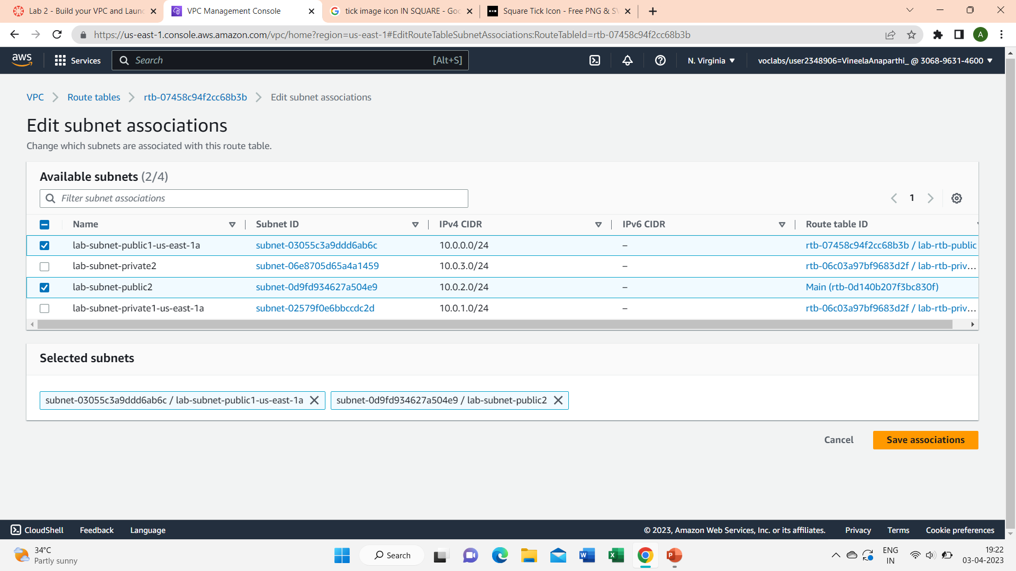
Leave lab-subnet-private1-us-east-1a selected, but also select lab-subnet-private2.
Choose Save associations
Select the lab-rtb-public route table.
In the lower pane, choose the Routes tab.
Choose the Subnet associations tab.
In the Explicit subnet associations panel, choose Edit subnet associations
Leave lab-subnet-public1-us-east-1a selected, but also select lab-subnet-public2.
Choose Save associations

Slide 37
Task 3: Create a VPC Security Group
Step 1:In the left navigation pane, choose Security groups.
Step 2:Choose Create security group and then configure:
Security group name:Web Security Group
Description: Enable HTTP access
VPC:choose the X to remove the currently selected VPC, then from the drop down list choose lab-vpc
In the Inbound rules pane, choose Add rule
Configure the following settings:
Type: HTTP
Source: Anywhere-IPv4
Description:permit web requests
Scroll to the bottom of the page and choose Create security group

Slide 38
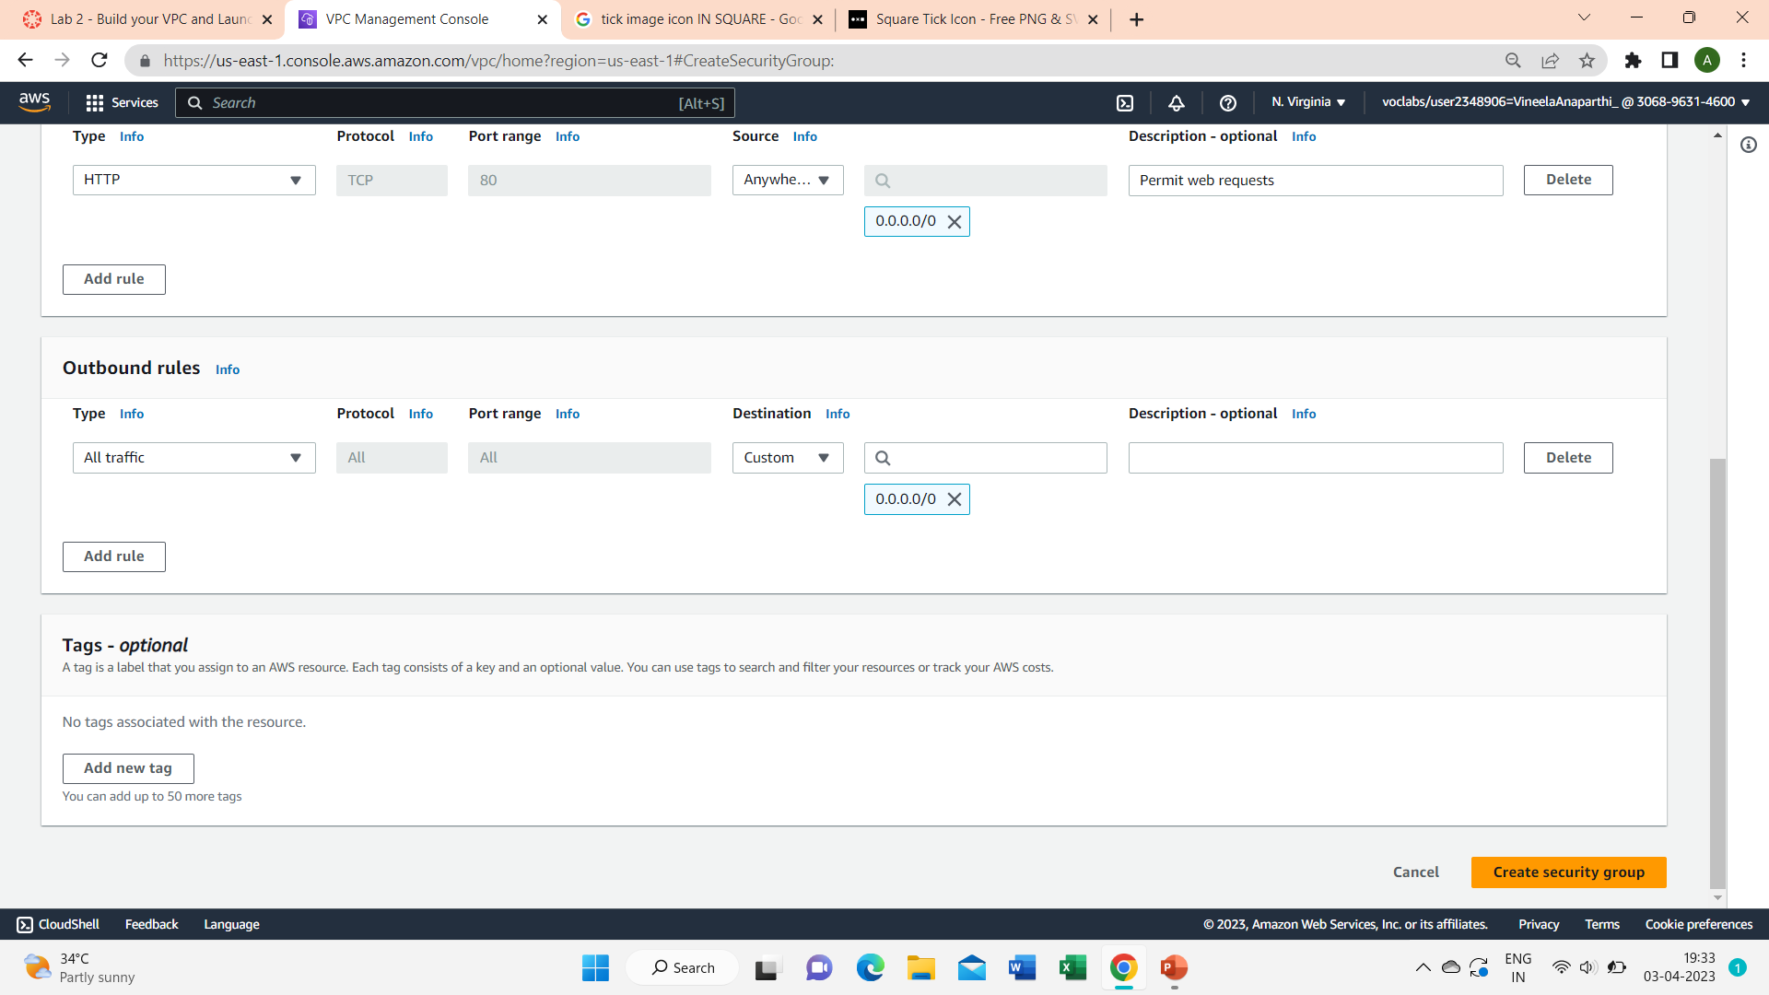
Task 4: Launch a Web Server Instance
Step 1:In the search box to the right of Services, search for and choose EC2 to open the EC2 console.
From the Launch instance menu choose Launch instance.
Name the instance:
Give it the name :Web Server 1
Step 2:Choose an AMI from which to create the instance:
In the list of available Quick Start AMIs, keep the default Amazon Linux selected.
Also keep the default Amazon Linux 2023 AMI selected.

Slide 39
Step 3:Choose an Instance type:
In the Instance type panel, keep the default t2.micro selected.
Select the key pair to associate with the instance:
From the Key pair name menu, select vockey.
Step 4:Configure the Network settings:
Next to Network settings, choose Edit, then configure:
Network: lab-vpc
Subnet: lab-subnet-public2 (not Private!)
Auto-assign public IP: Enable
Next, you will configure the instance to use the Web Security Group that you created earlier.
Under Firewall (security groups), choose Select existing security group.
Step 5:For Common security groups, select Web Security Group.
In the Configure storage section, keep the default settings.
Configure a script to run on the instance when it launches:
Expand the Advanced details panel.

Slide 40
Scroll to the bottom of page and then copy and paste code shown below into User data box:
#!/bin/bash
# Install Apache Web Server and PHP
sudo dnf install -y httpd wget php mariadb105-server
# Download Lab files
wget https://aws-tc-largeobjects.s3.us-west-2.amazonaws.com/CUR-TF-100-ACCLFO- 2-9026/2-lab2-vpc/s3/lab-app.zip
unzip lab-app.zip -d /var/www/html/
# Turn on web server
chkconfig httpd on
service httpd start
Step 5:At the bottom of the Summary panel on the right side of the screen choose Launch instance
Choose View all instances

Slide 41
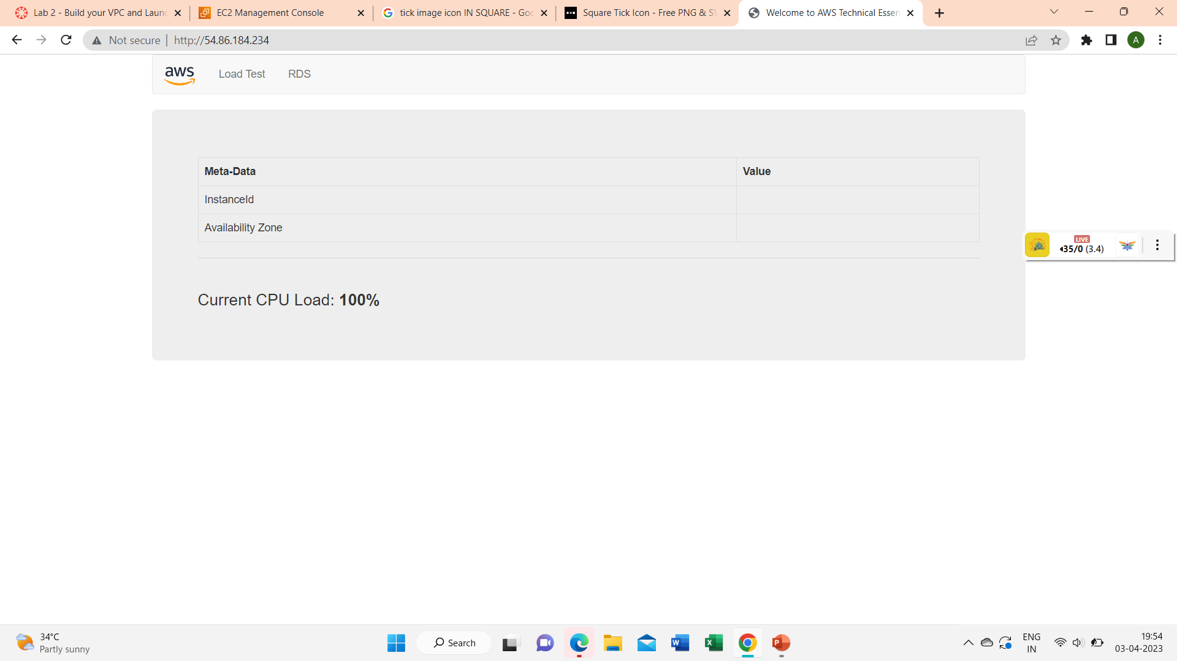
Wait until Web Server 1 shows 2/2 checks passed in the Status check column.
Select Web Server 1.
Copy the Public IPv4 DNS value shown in the Details tab at the bottom of the page.
Open a new web browser tab, paste the Public DNS value and press Enter.
You should see a web page displaying the AWS logo and instance meta-data values.

Slide 42
Lab 3 : Introduction to Amazon EC2
Step-1:
In the AWS Management Console choose Services, choose Compute and then choose EC2.
Step-2:
Choose the Launch instance menu and select Launch instance.
Step-3:
Give the instance the name as you prefer(eg:user)
Step-4:
Choose AMI as your preference.
Step-5:
In the Instance type panel, keep the default t2.micro selected.
Step-6:
For Key pair name - required, choose vockey.
Step-7:
Next to Network settings, choose Edit. For VPC, select Lab VPC.
Step-8:
Under Firewall (security groups), choose Create security group and configure:
Security group name: User security group
Description: Security group for my user server

Slide 43
Step-9:
Under Inbound security group rules, notice that one rule exists. Remove this rule.
Step-10:
In the Configure storage section, keep the default settings.
Step-11:
Expand Advanced details. For Termination protection, select Enable.
Copy the given code in the User Data Field:
#!/bin/bash
yum -y install httpd
systemctl enable httpd
systemctl start httpd
echo '<html><h1>Hello From Your Web Server!</h1></html>' > /var/www/html/index.html
Step-12:Click Launch Instance

Slide 44
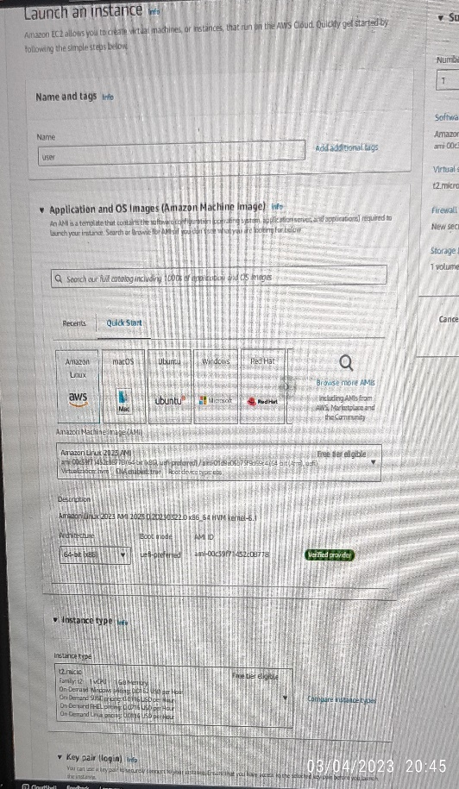
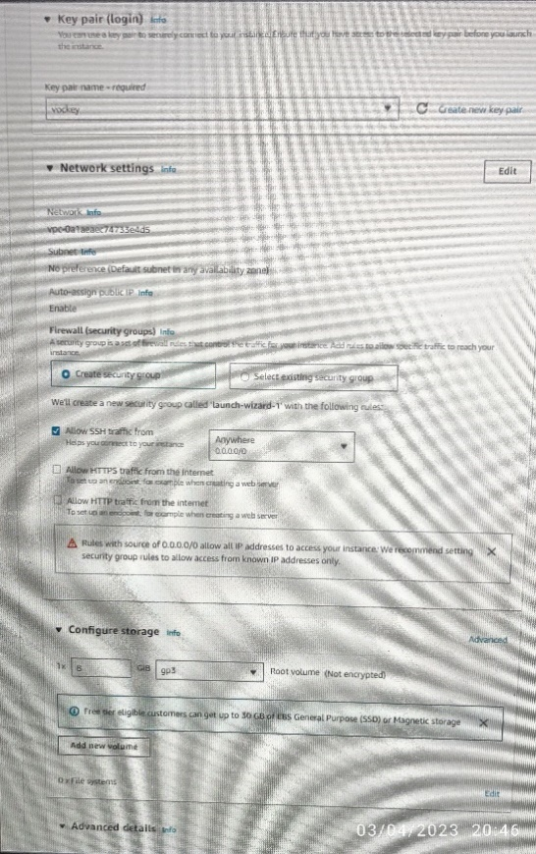
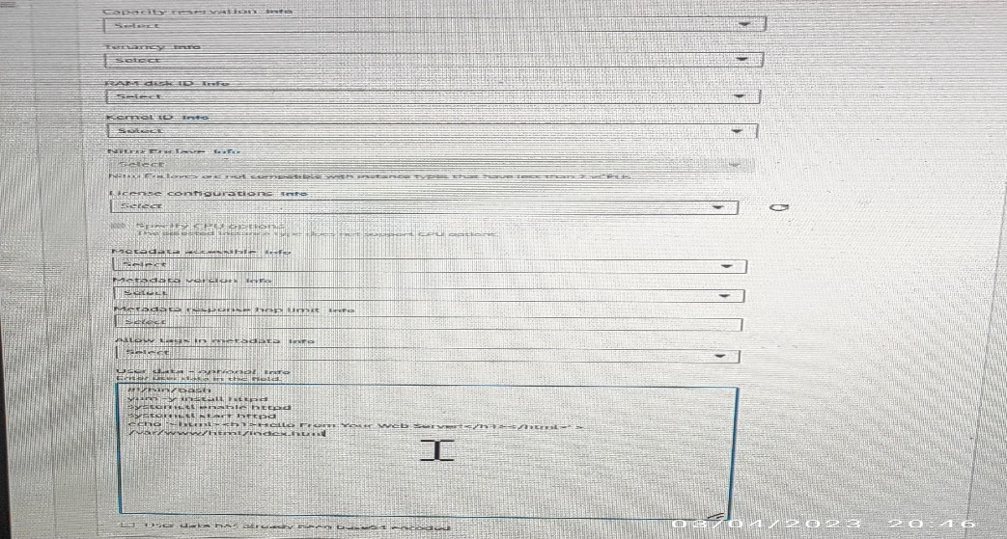
Step-13:
Wait for your instance to display the following: Instance State: Running.Status Checks: 2/2 checks passed
Step-14:
Choose the Status checks tab.
Step-15:
Choose the Monitoring tab.

Slide 45
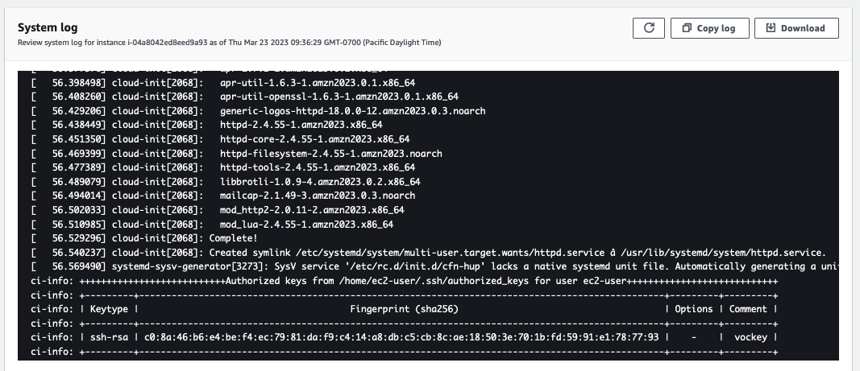
Step-16:
In the Actions menu towards the top of the console, select Monitor and troubleshoot Get system log.
Step-17:
Scroll through the output and note that the HTTP package was installed from the user data that you added when you created the instance.
Step-18: Choose Cancel.Ensure Web Server is still selected. Then, in the Actions menu, select Monitor and troubleshoot Get instance screenshot. Choose Cancel.
Step-19: Ensure Web Server is still selected. Choose the Details tab.Copy the Public IPv4 address of your instance to your clipboard.

Slide 46
Step-20:
Open a new tab in your web browser, paste the IP address you just copied, then press Enter.
Step-21:Keep the browser tab open, but return to the EC2 Console tab.
In the left navigation pane, choose Security Groups.
Select Web Server security group.
Step-22:
Choose the Inbound rules tab.
Choose Edit inbound rules, select Add rule and then configure:
Type: HTTP
Source: Anywhere-IPv4
Choose Save rules
Step-23: On the EC2 Management Console, in the left navigation pane, choose Instances.
Web Server should already be selected.
In the Instance State menu, select Stop instance.
Step-24:
In the Actions menu, select Instance settings Change instance type, then configure: Instance Type: t2.small Choose Apply

Slide 47
Step-25:
With the Web Server instance still selected, choose the Storage tab, select the name of the Volume ID, then select the checkbox next to the volume that displays.In the Actions menu, select Modify volume. Change the volume size from 8 gib to 10gib
Step-26:
In left navigation pane, choose Instances.Select the Web Server instance.In the Instance state menu, select Start instance.
Step-27:
In the left navigation pane, choose Limits.
From the All limits drop down list, choose Running instances.
Step-28:In left navigation pane, choose Instances.Select the Web Server instance and in the Instance state menu, select Terminate instance.
Then choose Terminate
Step-29:
In the Actions menu, select Instance settings Change termination protection. Remove the check next to Enable.
Choose Save.
You can now terminate the instance.Select the Web Server instance again and in the Instance state menu, select Terminate instance.
Step-30:
Choose Terminate

Slide 48
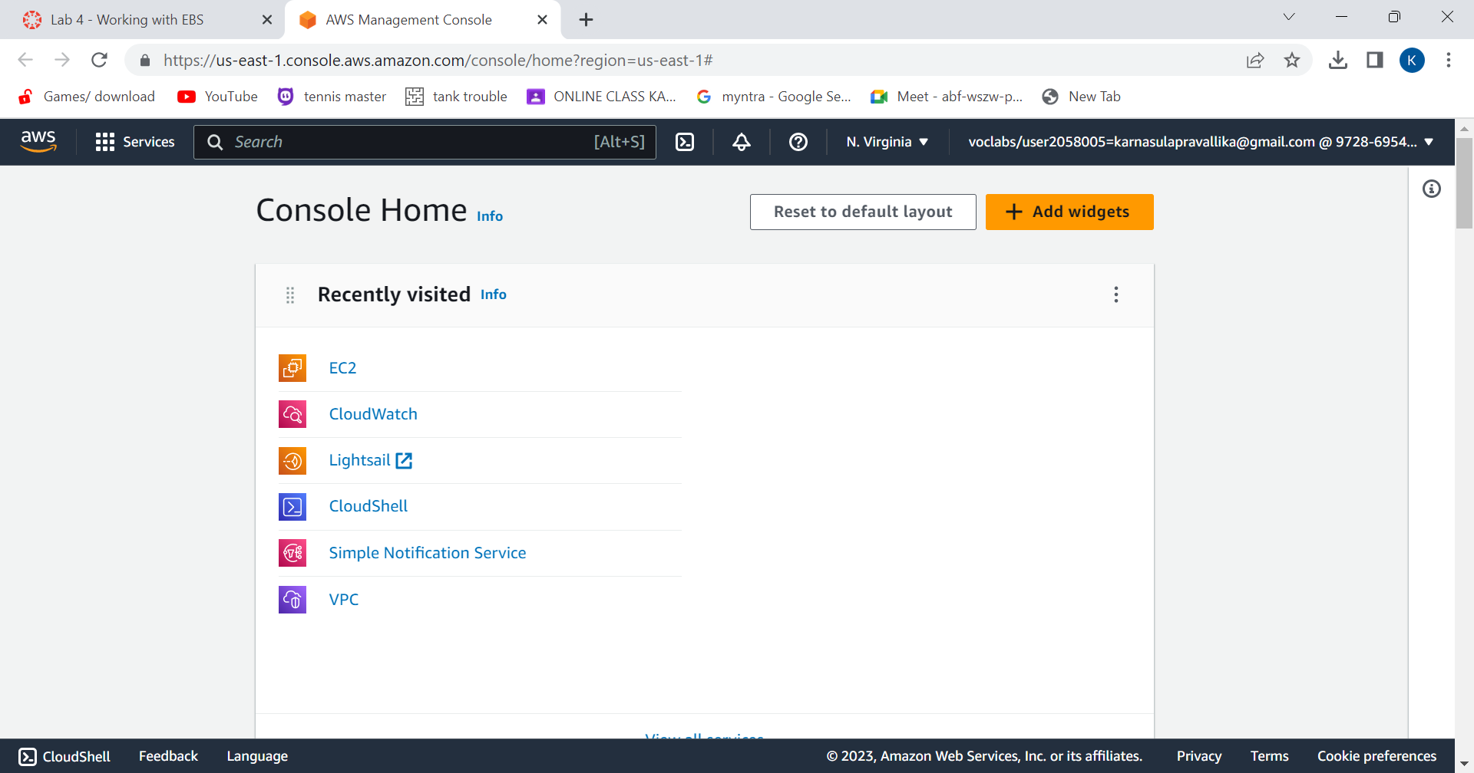
Create a New EBS Volume
Lab 4 : Working With EBS
On “Services” menu, click EC2.

Slide 49


choose instances.
Lab has already been launched.

Slide 50


choose Volumes. Then choose “Create Volume”.
Configure the volume settings.

Slide 51


Add tag and choose “create volume”.
Volume is created. Select “My Volume” and in the
Actions menu,choose “Attach Volume”.

Slide 52

Choose the Instance field and choose
“Attach Volume”. Then the volume will be in use.

Slide 53



Redirecting to instructions panel, choose Details and click on Show.
Credentials window will open and choose Download PPK button and
save the labuser.ppk file.

Slide 54

Now, You will use PuTTY to SSH to Amazon EC2 instances.
Open putty.exe and configure like below:
Choose Connection.
Set Seconds between keepalives to 30.
Choose Session
Host Name (or IP address): Paste the Public DNS or IPv4 address of the Lab instance that you noted earlier.
Back in PuTTY, in the Connection list, expand SSH
Choose Auth and expand Credentials
Under Private key file for authentication: Choose Browse
Browse to the labsuser.ppk file that you downloaded, select it, and choose Open
Choose Open again.
To trust and connect to the host, choose Accept.
When prompted login as, enter: ec2-user

Slide 55



Slide 56



create and configure your file system.
In PuTTY, by executing certain commands, you will
View the storage available on your instance.
Create an ext3 file system on the new volume.
Create a directory for mounting the new storage volume.
Mount the new volume.
View the configuration file to see the setting on the last line.
create a file and add some text to it.
Verify that the text has been written to your volume.

Slide 57


Create an Amazon EBS Snapshot.
create Volume from Snapshot.

Slide 58


Attach restored volume to your EC2 instance:
choose volumes and select restored volume.
in the Actions menu, select Attach volume.

Slide 59
Mount the restored volume.
Finally, You should see file.txt.

Slide 60
THANK YOU

